Slide 1

Start deck in “Slide Show” mode,
and use your up/down arrow keys and/or
your space bar to advance the slides
© 2010-2026 Timothy G. Roufs, University of Minnesota Duluth

Slide 2
ANTH 1080
Global Cultures
Main
Characteristics of
Anthropology
© 2010-2026 Timothy G. Roufs, University of Minnesota Duluth

Slide 3
ANTH 1080
Global Cultures
The Four Fields
of
American Anthropology
© 2010-2026 Timothy G. Roufs, University of Minnesota Duluth

Slide 4
American
Main Characteristics of˄Anthropology
1. the four fields of general anthropology
culture as a primary concept
comparative method as major approach
holism as a primary theoretical goal
fieldwork as a primary research technique

Slide 5
American
Main Characteristics of˄Anthropology
1. the four fields of general anthropology
culture as a primary concept
comparative method as major approach
holism as a primary theoretical goal
fieldwork as a primary research technique

Slide 6
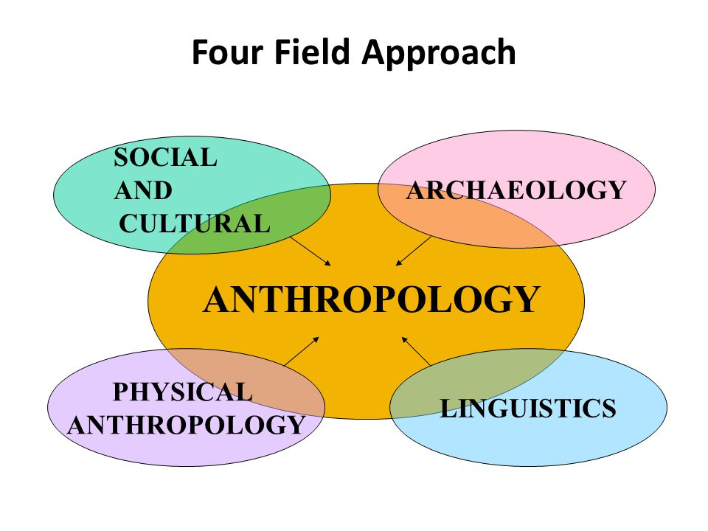
https://slideplayer.com/slide/2407456/9/images/66/Four+Field+Approach+SOCIAL+ARCHAEOLOGY+AND+CULTURAL+PHYSICAL.jpg

Slide 7
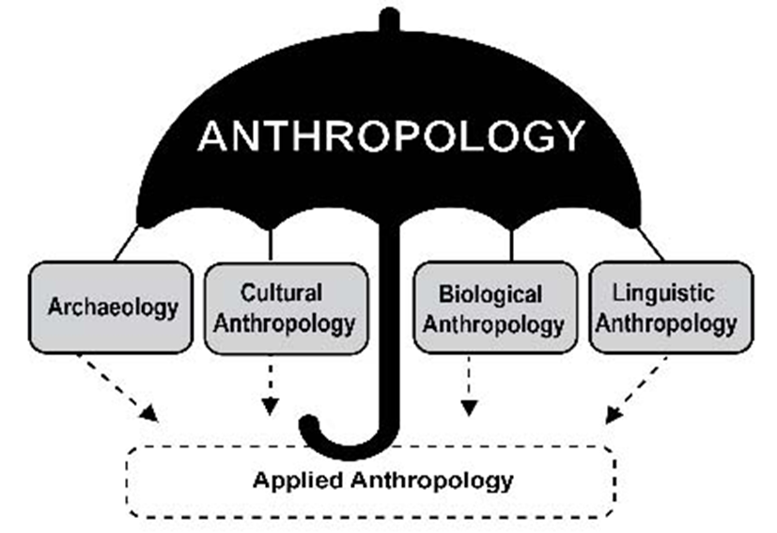

Slide 8
You’ll see the four field approach
in American Anthropology . . .
American Anthropology
cultural / social
physical
archaeology
linguistics

Slide 9
These are also commonly known as . . .

Slide 10
So . . . we’re going to have a look at . . .
sociocultural
biophysical
archaeological
linguistical

Slide 11
So . . . we’re going to have a look at . . .
sociocultural
biophysical
archaeological
linguistical
cultural / social
physical / biological
archaeological
linguistical

Slide 12
So . . . we’re going to have a look at . . .
sociocultural
biophysical
archaeological
linguistical
cultural / social
physical / biological
archaeological
linguistical

Slide 13
Main Characteristics
“culture” is
  learned
  shared
  transmitted from generation to generation
  based on symbols
  integrated

Slide 14
Main Characteristics
“culture”
  learned
  shared
  transmitted from generation to generation
  based on symbols
  integrated
some focus on the idea that it involves
“shared understanding”

Slide 15
Main Characteristics
“culture”
    is not inherited
  (i.e., is not biological)
    is not “instinct”

Slide 16
Main Characteristics
“cultures”
    are groups of people sharing a common heritage
    (and usually a common language)

Slide 17
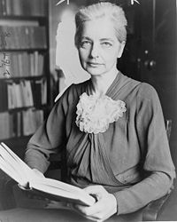
Main Characteristics
“cultures”
    are “integrated”
    -- an idea that was pioneered and emphasized by the “pioneer” anthropologist Ruth Benedict
Ruth Fulton Benedict
1887-1948
Patterns of Culture
1934

Slide 18
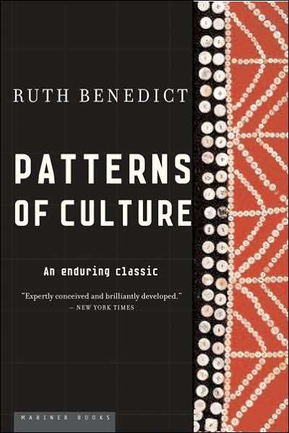
Ruth Fulton Benedict
1887-1948
Patterns of Culture
1934

Slide 19
Main Characteristics
“cultures”
    are integrated
    Interact and change
      the idea that some cultures
      (like “hunting and gathering” cultures, or the Amish)
      do not change is not correct

Slide 20
The Concept of Culture
microculture
  are smaller groups with distinct pattern of learned and shared behavior and thinking found within larger cultures such as ethnic groups in localized regions
  some people like to think of these as
  “local cultures”

Slide 21
The Concept of Culture
microculture
  are smaller groups with distinct pattern of learned and shared behavior and thinking found within larger cultures such as ethnic groups in localized regions
  some people like to think of these as
  “local cultures”

Slide 22
The Concept of Culture
microcultures can include ethnic groups within nations
  e.g., Greek-Americans
  e.g., Anishinabe (Chippewa; Ojibwa)
  e.g., Irish “Travellers”
    sometimes incorrectly called “Gypsies”
  e.g., Australian Aboriginals
  e.g., Cajun
  e.g., Rom (Gypsies)
  e.g., Basques
  e.g., Kurds

Slide 23
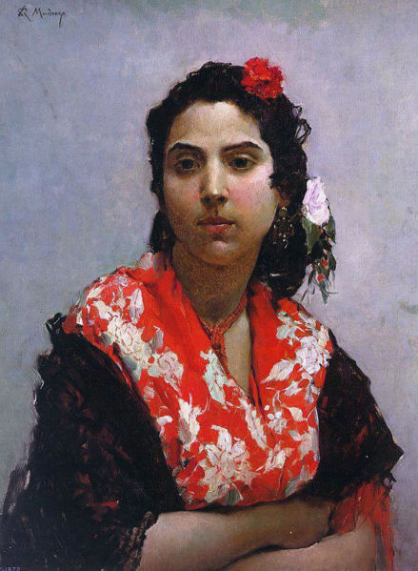
Gitana
Raimundo Madrazo
1841-1920
http://en.wikipedia.org/wiki/Main_Page

Slide 24
The Concept of Culture
microcultures can include ethnic groups within nations
  e.g., Greek-Americans
  e.g., Anishinabe (Chippewa; Ojibwa)
  e.g., Irish “Travellers”
    sometimes incorrectly called “Gypsies”
  e.g., Australian Aboriginals
  e.g., Cajun
  e.g., Rom (Gypsies)
  e.g., Basques
  e.g., Kurds
local groups generally strive to preserve their cultural identity

Slide 25
The Concept of Culture
local groups (microcultures)
generally strive to preserve their cultural identity with . . .
food
clothing
religion
ritual
music, dance, and other arts
language
cultural symbols . . .

Slide 26
The Concept of Culture
microcultures can include ethnic groups within nations
  e.g., Greek-Americans
  e.g., Anishinabe (Chippewa; Ojibwa)
  e.g., Irish “Travellers”
    sometimes incorrectly called “Gypsies”
  e.g., Australian Aboriginals
  e.g., Cajun
  e.g., Rom (Gypsies)
  e.g., Basques
  e.g., Kurds

Slide 27
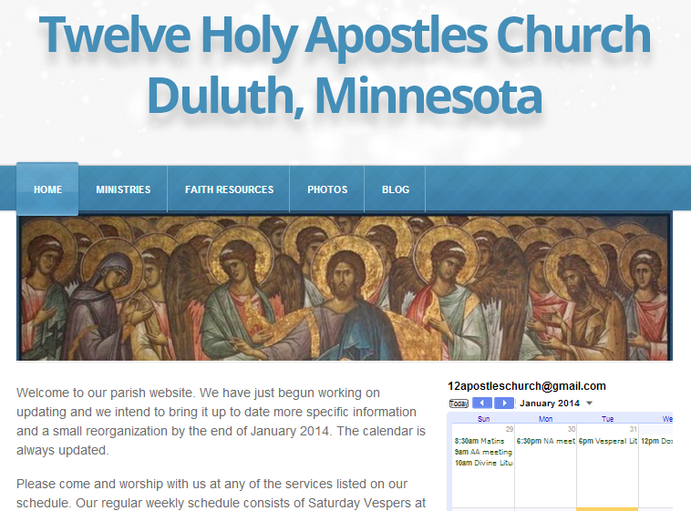
The Concept of Culture
microculture
  are smaller groups with distinct pattern of learned and shared behavior and thinking found within larger cultures such as ethnic groups in localized regions
  some people like to think of these as
  “local cultures”

Slide 28
The Concept of Culture
microculture
  are smaller groups with distinct pattern of learned and shared behavior and thinking found within larger cultures such as ethnic groups in localized regions
  some people like to think of these as
  “local cultures”
local groups generally strive to preserve their cultural identity . . .

Slide 29
The Concept of Culture
local groups (microcultures)
generally strive to preserve their cultural identity with . . .
food
clothing
religion
ritual
music, dance, and other arts
language
cultural symbols . . .

Slide 30
The Concept of Culture
local groups (microcultures)
generally strive to preserve their cultural identity with . . .
food
clothing
religion
ritual
music, dance, and other arts
language
cultural symbols . . .

Slide 31
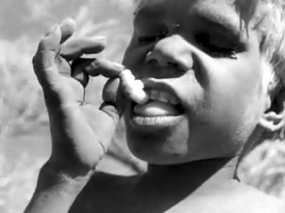
The Desert People

Slide 32
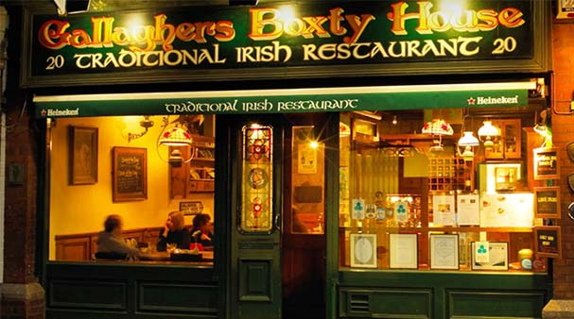
https://www.dublinpass.com/dublin-attractions/the-boxty-house.htmlhttps://www.dublinpass.com/dublin-attractions/the-boxty-house.html

Slide 33
So . . . we’re going to have a look at . . .
sociocultural
biophysical
archaeological
linguistical
cultural / social
physical / biological
archaeological
linguistical

Slide 34
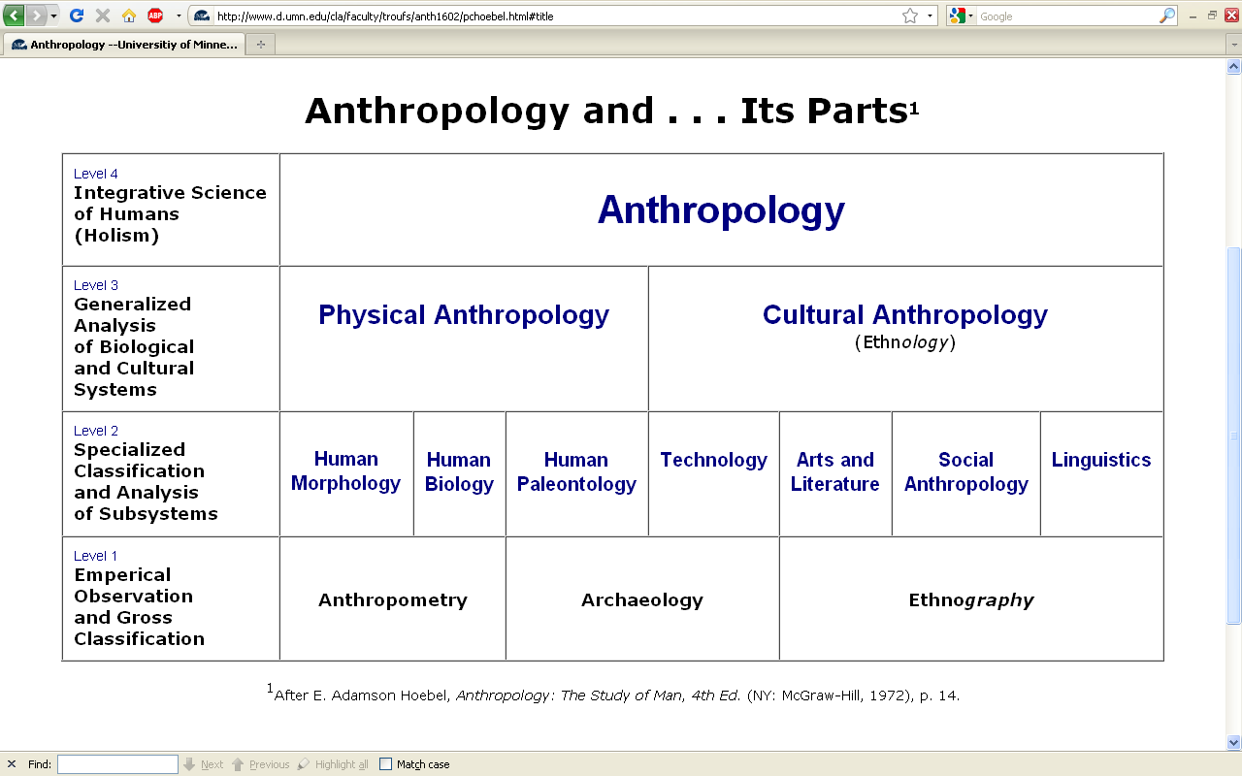
Understanding Global Cultures
Anthropology
Bio-physical
URL link to print: https://www.d.umn.edu/cla/faculty/troufs/anth1602/pchoebel.html#title

Slide 35
. . . biophysical looks at all things biological and physical, and involves
subjects like . . .

Slide 36

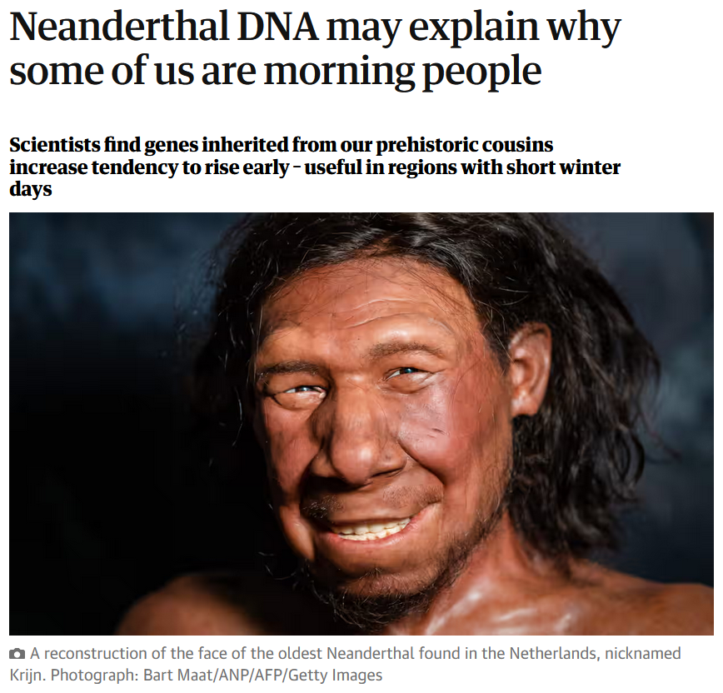
14 December 2023
https://www.theguardian.com/science/2023/dec/14/neanderthal-dna-may-explain-why-some-of-us-are-morning-people?CMP=share_btn_link

Slide 37
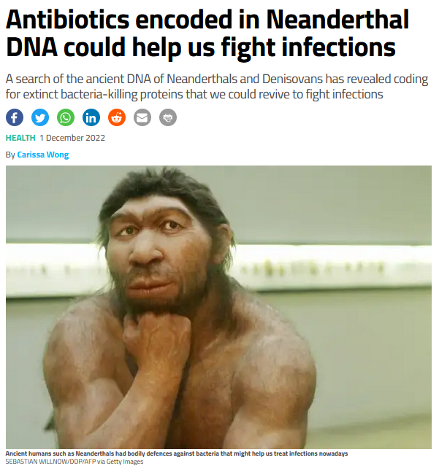

1 December 2022
https://www.newscientist.com/article/2349196-antibiotics-encoded-in-neanderthal-dna-could-help-us-fight-infections/

Slide 38
. . . biophysical involves
things like . . .

Slide 39
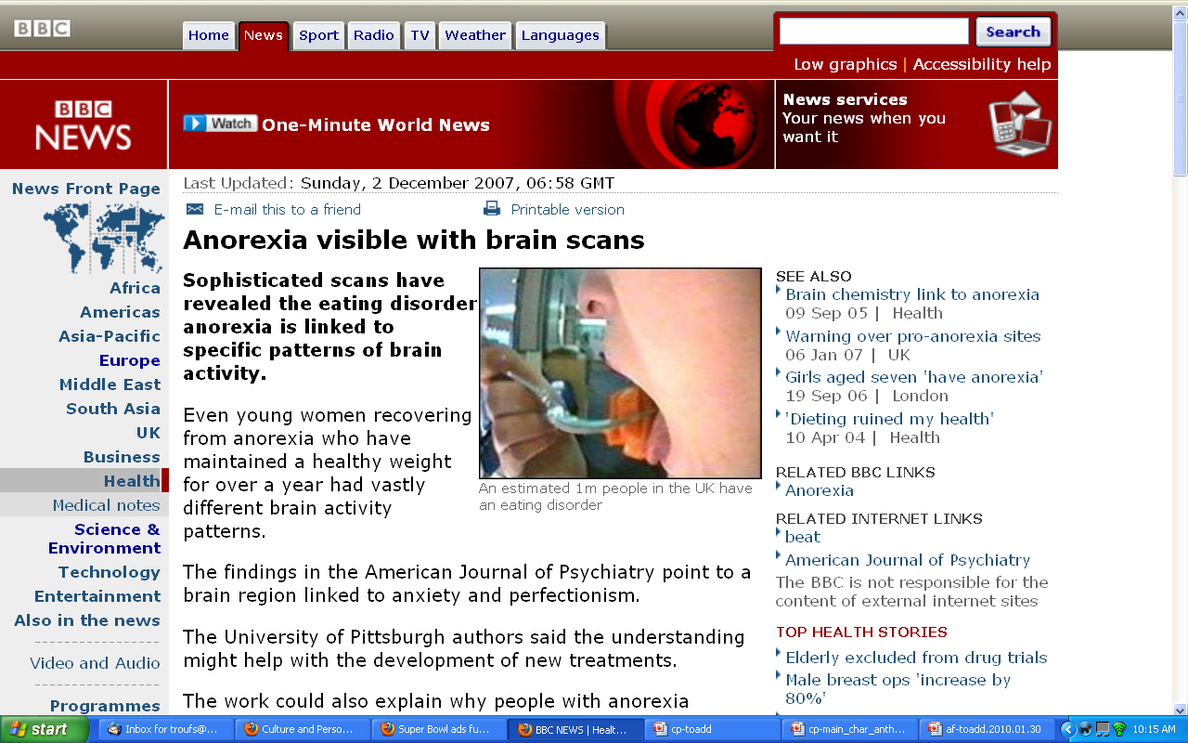
http://news.bbc.co.uk/2/hi/health/7120564.stm

Slide 40
. . . and biophysical involves
things like . . .

Slide 41
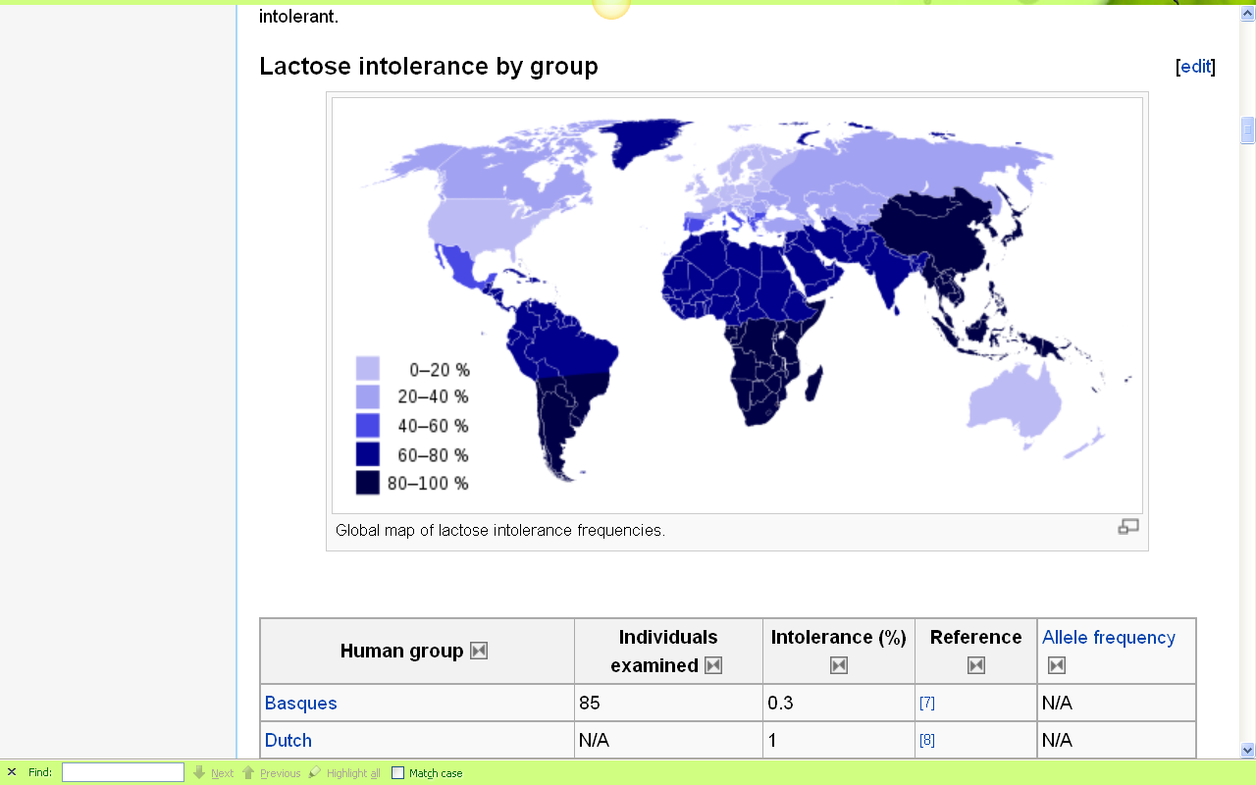
Europeans are some of the few peoples of the world that can drink milk without getting sick
http://en.wikipedia.org/wiki/Lactose_intolerance

Slide 42

Penguin Avery, 2009

Slide 43
. . . but ultimately anthropologists seek to study phenomena in terms of both physical and cultural aspects
. . .

Slide 44
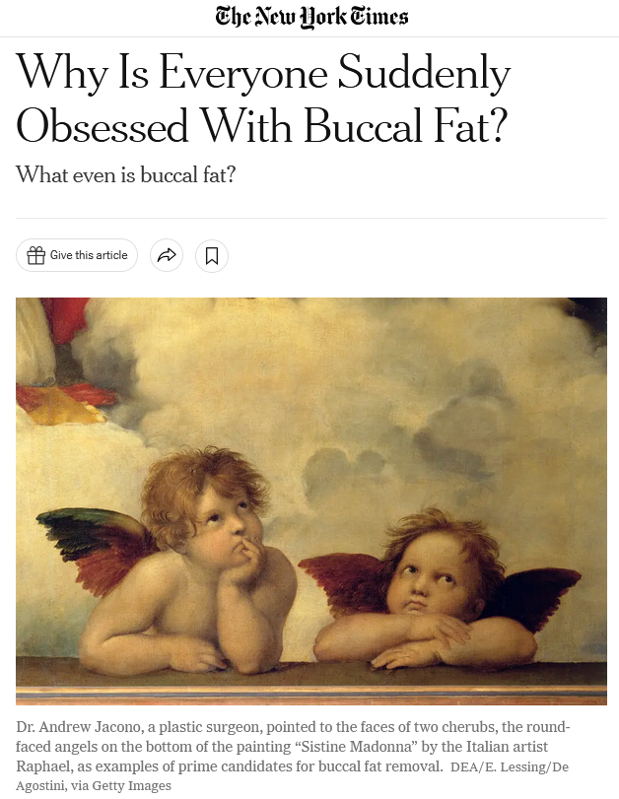
16 December 2022
https://www.nytimes.com/2022/12/16/style/buccal-fat-removal-tiktok-plastic-surgery.html?smid=em-share

Slide 45
Understanding Global Cultures
Anthropology
Bio-physical
Cultural
URL link to print: https://www.d.umn.edu/cla/faculty/troufs/anth1602/pchoebel.html#title

Slide 46
  for example, numerous studies have shown that exposure to images [cultural] of ultrathin models can lead to body dissatisfaction and eventually to unhealthy eating behaviors and physical illness [physical] . . .
The Cultural Feast, 2nd ed., p. 115

Slide 47

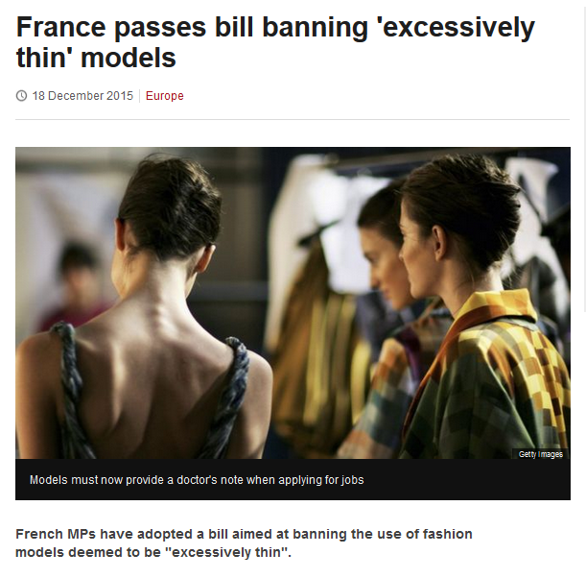
http://www.bbc.com/news/world-europe-35130792

Slide 48
So . . . we’re going to have a look at . . .
sociocultural
biophysical
archaeological
linguistical
cultural / social
physical / biological
archaeological
linguistical

Slide 49
. . . archaeology investigates cultures of the past, and questions of how things that we see today came to be that way, including forensics . . .

Slide 50
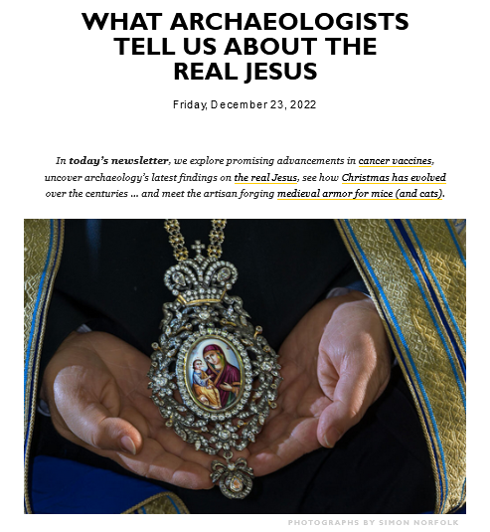
23 December 2022
https://outlook.live.com/mail/0/inbox/id/AQQkADAwATY0MDABLThjYwAxLTJjN2YtMDACLTAwCgAQAO9LDmUJCQBBSasELYWIBD7v

Slide 51
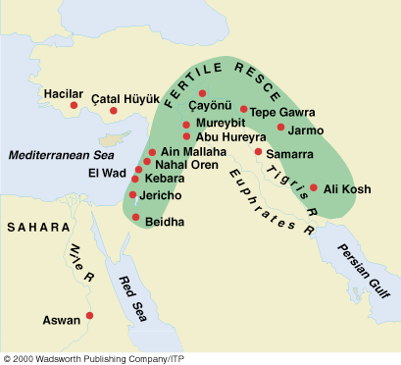
Early Neolithic sites
Understanding Physical Anthropology and Archaeology, 9th Ed., p. 349.

Slide 52
the comparative method compares things, for e.g., process of domestication / civilization
    maize – Mexico
    wheat – Turkey
    rice – China
    manioc – Brazil
    millet – Africa

Slide 53
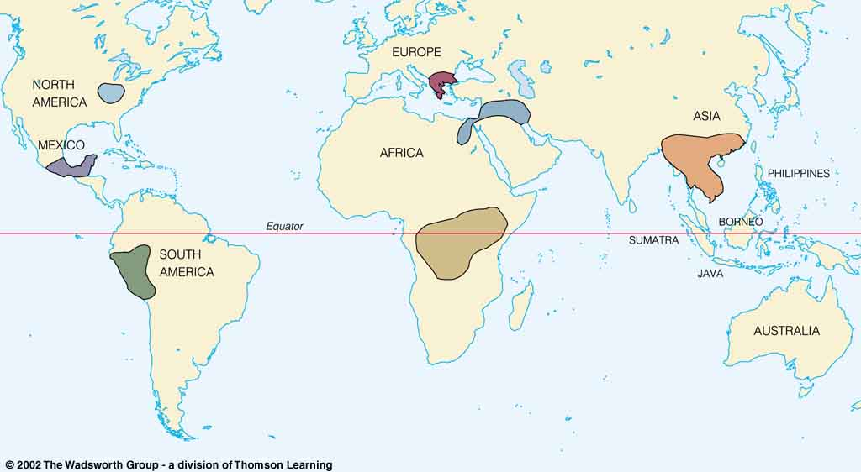
Origin of Domestication for Selected Plants
Compare . . .
wheat
10,500 ybp
maize
4,200 ybp
rice
7,000 ybp
manioc
4,200 ybp
millet
4,000 ybp
Understanding Physical Anthropology and Archaeology, 9th Ed., p. 342.

Slide 54

F. J. Simoons
1994
Eat not this Flesh, Food Avoidances from Pre-history to Present.
Madison: University of Wisconsin Press.

Slide 55
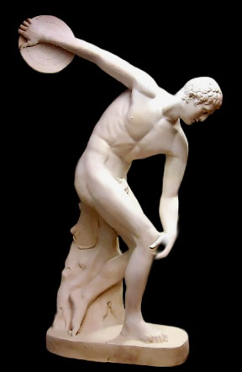
Discus Thrower
ca. 460 B.C.
http://www.crystalinks.com/greekart.html

Slide 56
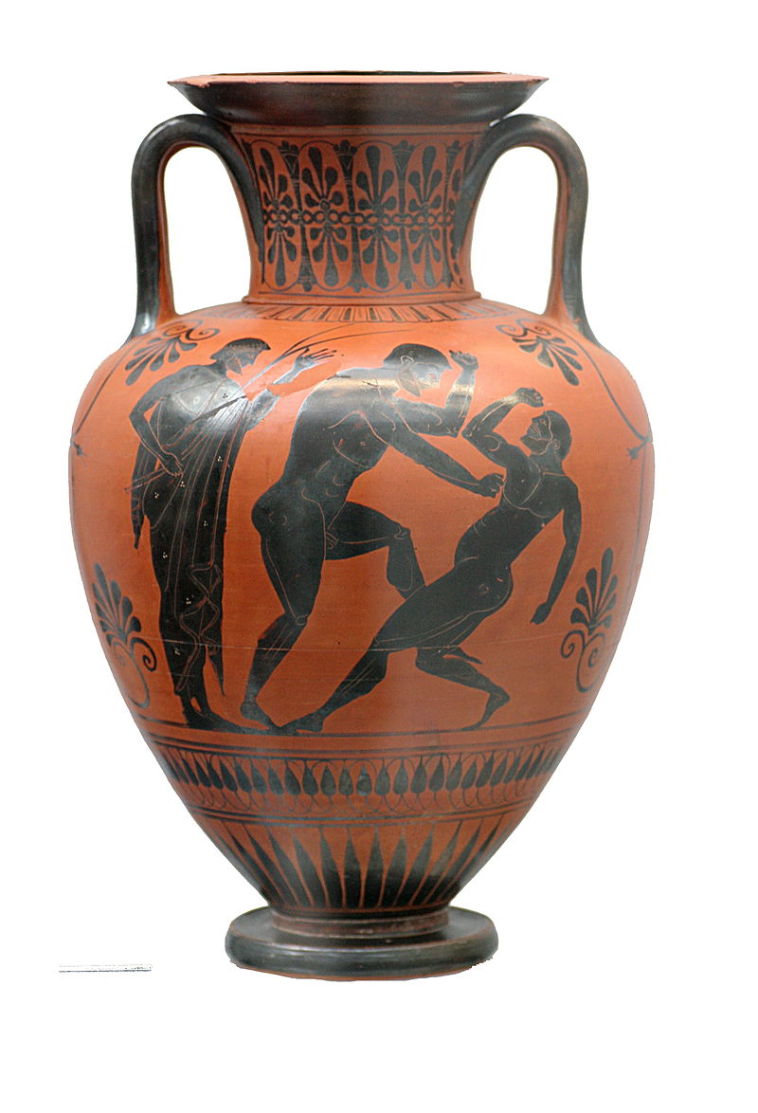
Black figure Amphora
Atalante painter
500-490 B.C.
https://en.wikipedia.org/wiki/Ancient_Greek_architecture#/media/File:Boxers_Staatliche_Antikensammlungen_1541.jpg

Slide 57
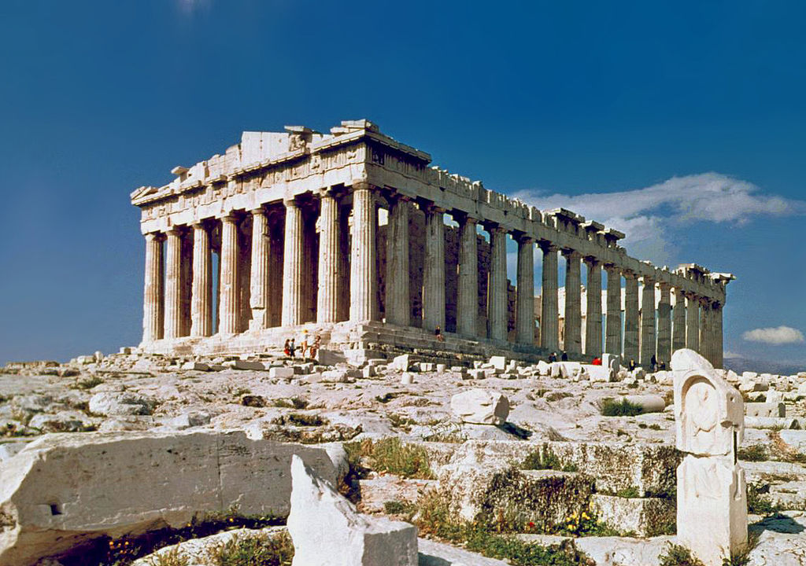
https://en.wikipedia.org/wiki/Ancient_Greek_architecture#/media/File:O_Partenon_de_Atenas.jpg

Slide 58
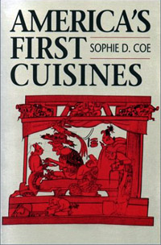
Aztec
Maya
Inca
Sophie D. Coe
America's First Cuisines
Austin: University of Texax Press, 1994.
www.d.umn.edu/cla/faculty/troufs/anthfood/aftexts.html#title

Slide 59
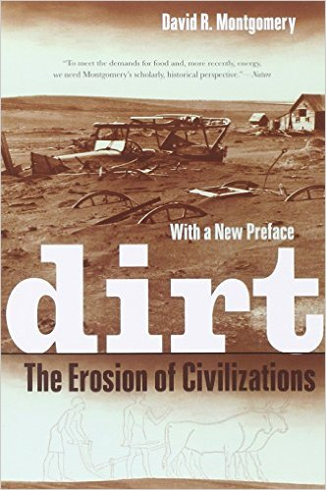
Mesopotamia
China
North America
South America
Europe
Asia
Africa
Pacific Islands
Berkeley: University of California, 2012
http://www.amazon.com/Empires-Food-Feast-Famine-Civilizations/dp/1582437939/ref=sr_1_1?ie=UTF8&qid=1452654498&sr=8-1&keywords=empires+of+food

Slide 60

Mesopotamia
China
North America
South America
Europe
Asia
Africa
Pacific Islands
Berkeley: Counterpoint, 2012:
http://www.amazon.com/Empires-Food-Feast-Famine-Civilizations/dp/1582437939/ref=sr_1_1?ie=UTF8&qid=1452654498&sr=8-1&keywords=empires+of+food

Slide 61
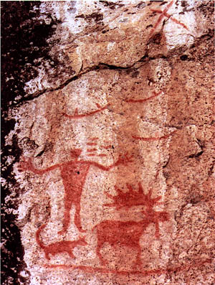
Pictograph from Hegman Lake, Minnesota

Slide 62
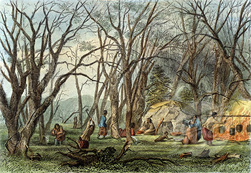
Indian Sugar Camp, 1853
Seth Eastman (1808-1878 American)
Newberry Library, Chicago

Slide 63
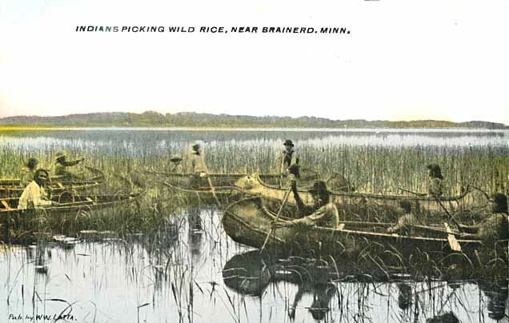
Indians harvesting wild rice near Brainerd, 1905.
.Minnesota Historical Society

Slide 64
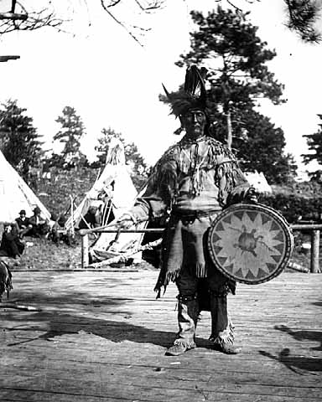
Chippewa medicine man singer with ceremonial turtle clan drum.
Photograph Collection ca. 1900
Minnesota Historical Society, Negative No. 21120

Slide 65
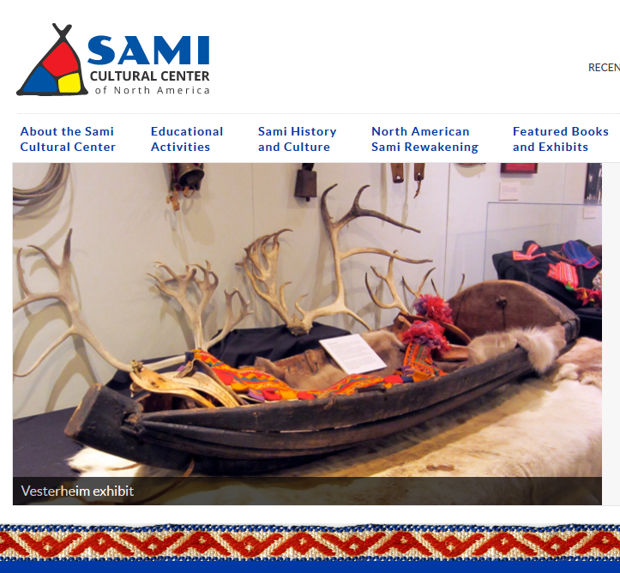

http://www.samiculturalcenter.org/
Notes:
65

Slide 66
. . . and finally . . .

Slide 67
So . . . we’re going to have a look at . . .
sociocultural
biophysical
archaeological
linguistical
cultural / social
physical / biological
archaeological
linguistical

Slide 68
. . . linguistics looks at languages and dialects historically, psychologically, and culturally . . .

Slide 69

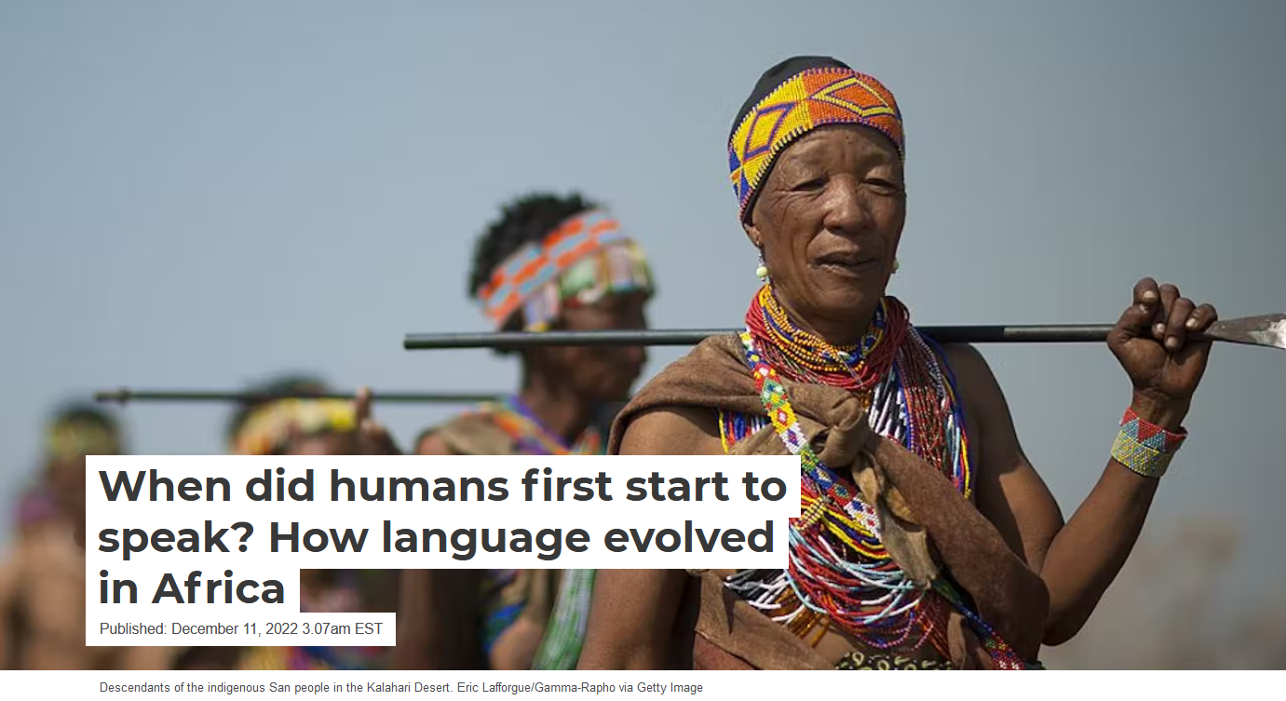
December 11, 2022
https://theconversation.com/when-did-humans-first-start-to-speak-how-language-evolved-in-africa-194372

Slide 70
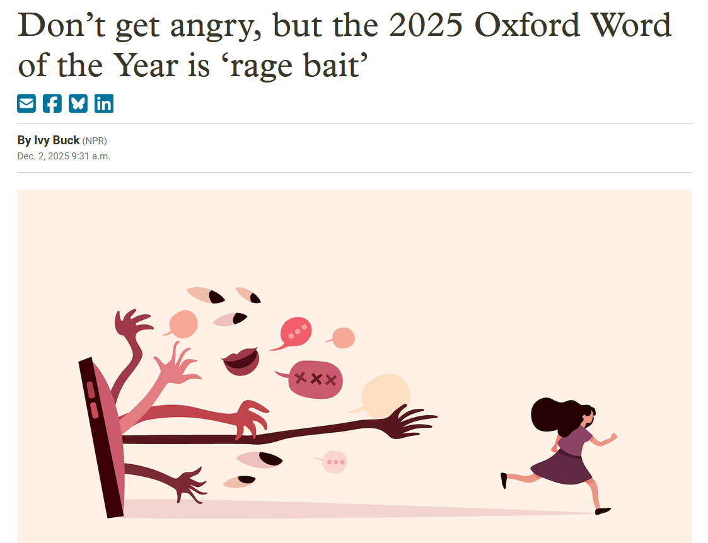

https://www.opb.org/article/2025/12/02/rage-bait-is-2025-oxford-word-of-the-year/

Slide 71
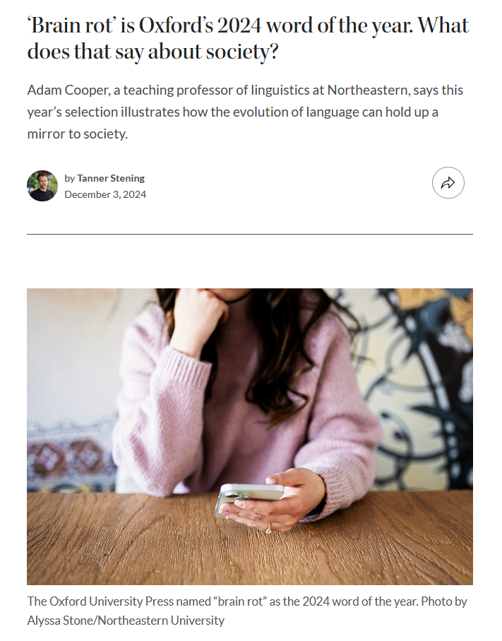
https://news.northeastern.edu/2024/12/03/brain-rot-oxford-word-of-the-year/

Slide 72
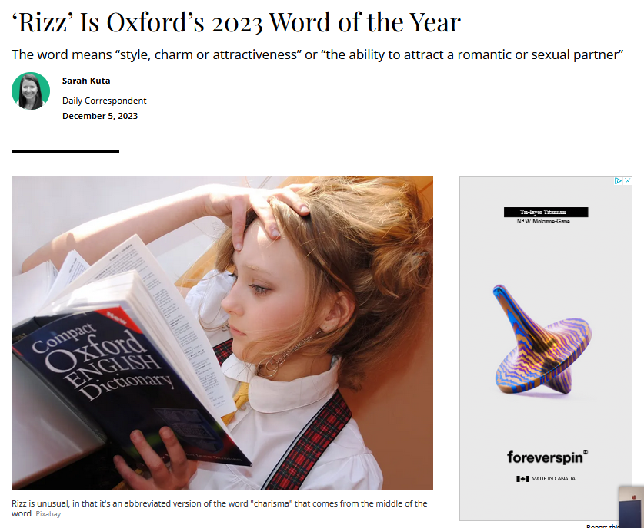
https://www.smithsonianmag.com/smart-news/rizz-is-oxfords-2023-word-of-the-year-180983367/

Slide 73
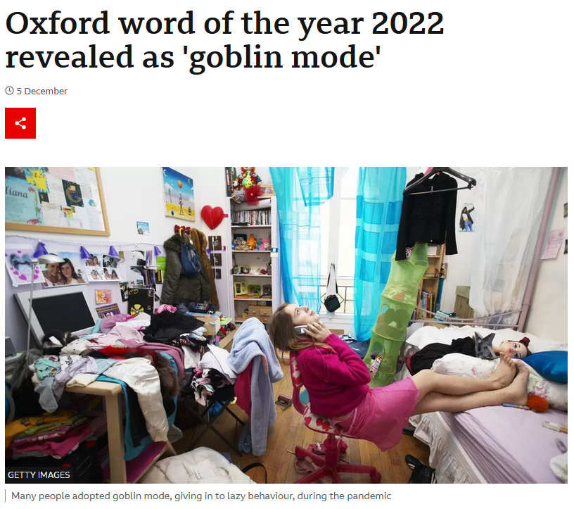
December 11, 2022
https://www.bbc.co.uk/news/uk-63857329

Slide 74
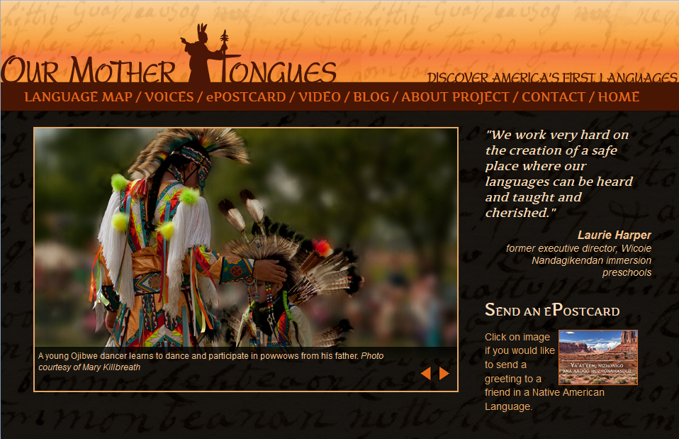
http://ourmothertongues.org/language/Ojibwe/9

Slide 75
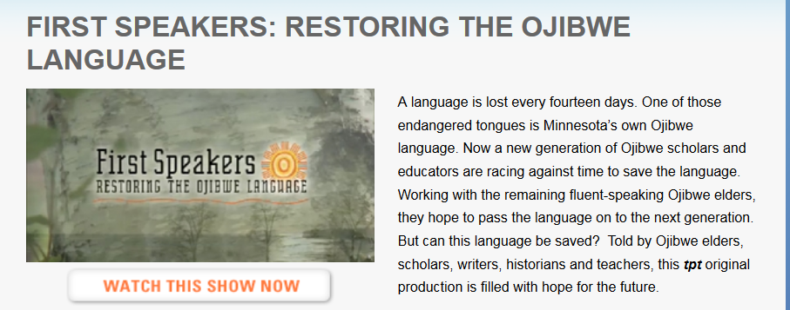
http://cla.umn.edu/ais/undhttp://www.tpt.org/?a=productions&id=3rgraduate/dakota-ojibwe-language-programs

Slide 76
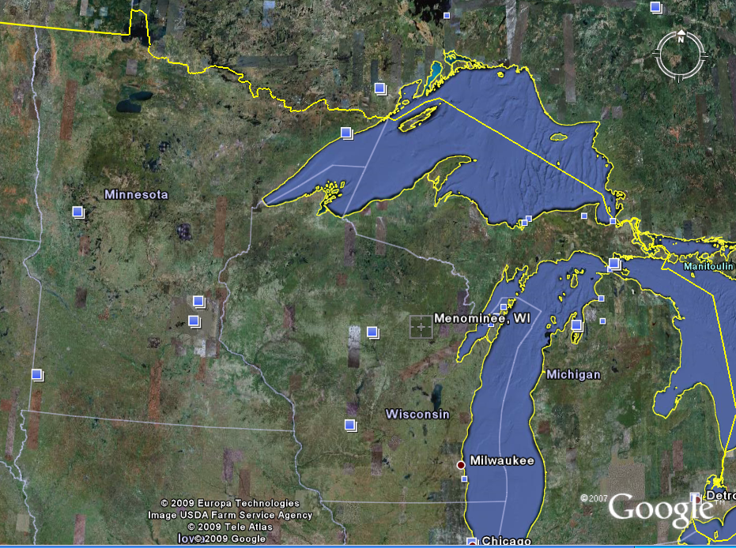
Wisconsin
Place Names
include
Menominee (“wild rice”)
Kenosha (ginoozhe “pike”)
Kewaunee (“prairie hen / wild duck”) . . .

Slide 77
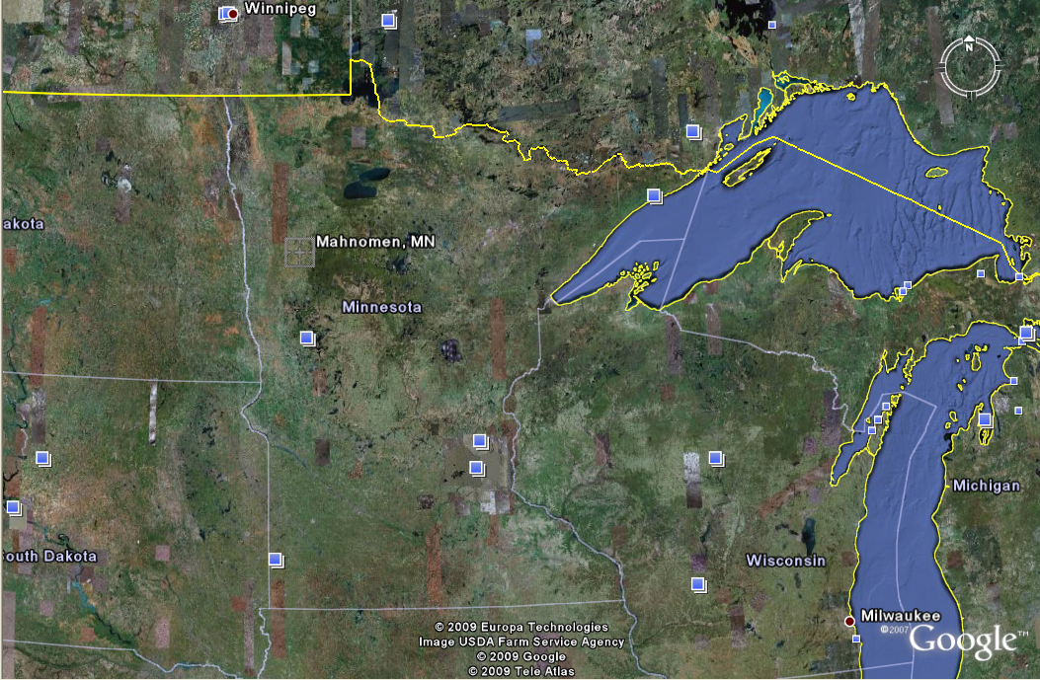
Minnesota
Place Names
include
Mahnomen (“wild rice”)
Mahnomen County
Nibish (“tea”)
Menahga (“blueberry”) . . .

Slide 78
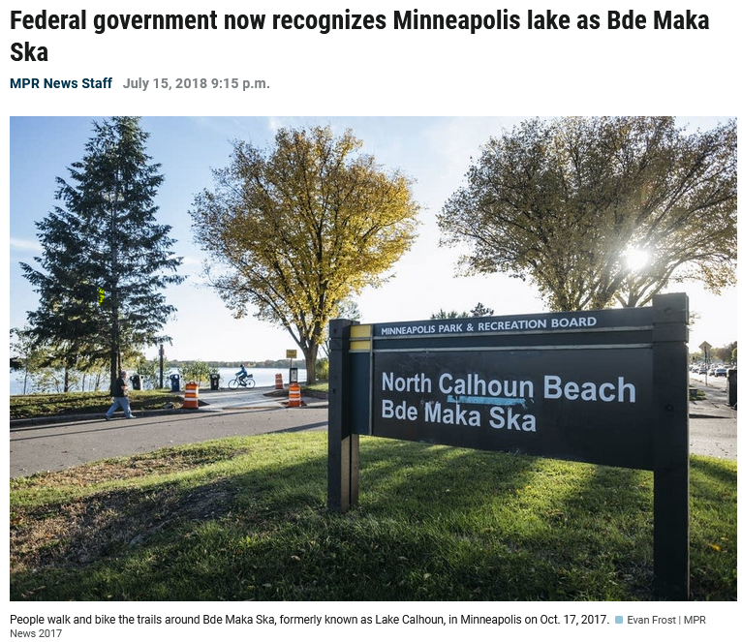

Slide 79

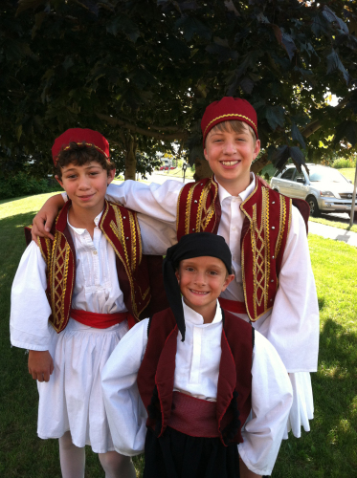
for e.g., names often reinforce one’s cultural identity
A Taste of Greece
22nd Annual Food Festival 2014
Dima Sevastiades, Styli Regas and Demetri Bush wear their dance costumes for the Taste of Greece.
(Photo by Patra Sevastiades)

Slide 80
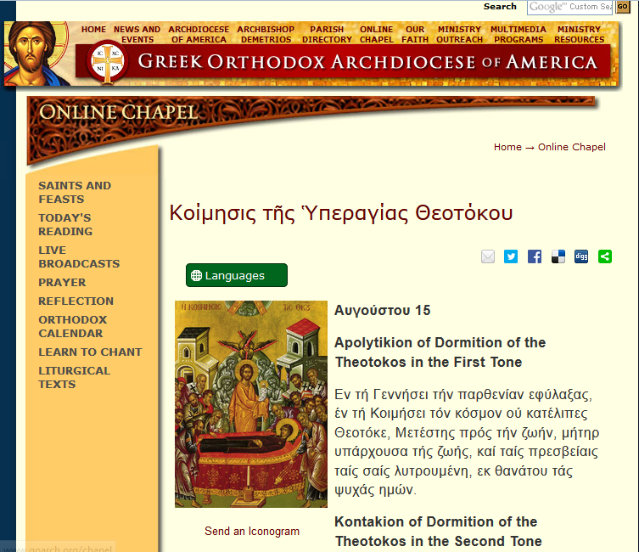
http://www.goarch.org/chapel/saints_view?contentid=165&date=8/15/2015&D=SA&language=el

Slide 81
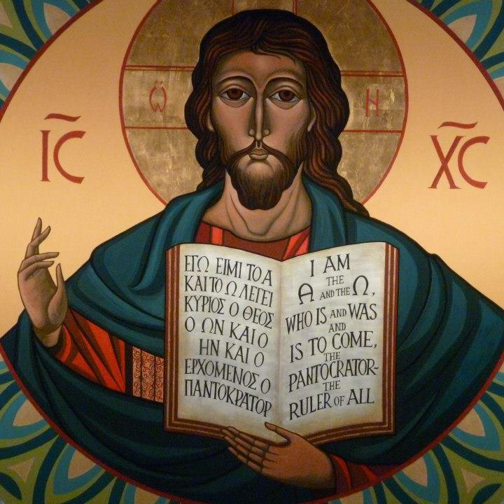
https://www.facebook.com/12HolyApostlesChurch/photos/

Slide 82
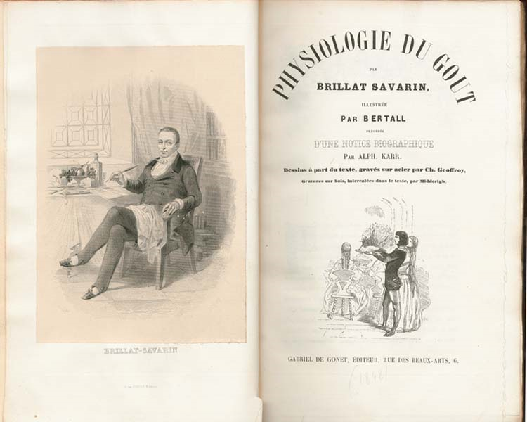
. . . This is one of the few books next to the Bible said to have never been out of print since its first edition
1875
http://en.wikipedia.org/wiki/Brillat-Savarin
Notes:
82

Slide 83
Main Characteristics in a Nutshell

Slide 84
American
Main Characteristics of˄Anthropology
1. the four fields of general anthropology
culture as a primary concept
comparative method as major approach
holism as a primary theoretical goal
fieldwork as a primary research technique

Slide 85
ANTH 1080
Global Cultures
The End
The Four Fields
of
American Anthropology
© 2010-2026 Timothy G. Roufs, University of Minnesota Duluth

