Slide 1
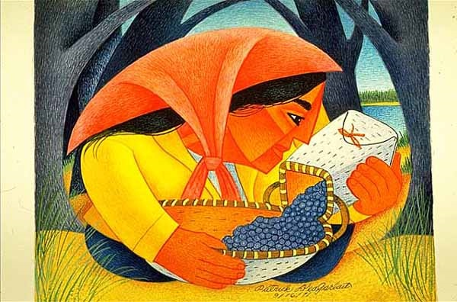
Start deck in “Slide Show” mode,
and use your up/down arrow keys and/or
your space bar to advance the slides
University of Minnesota Duluth
Tim Roufs
© 2010-2026

Slide 2
ANTH 3888
Global Cultures
Main
Characteristics of
Anthropology
University of Minnesota Duluth
Tim Roufs
© 2010-2026

Slide 3
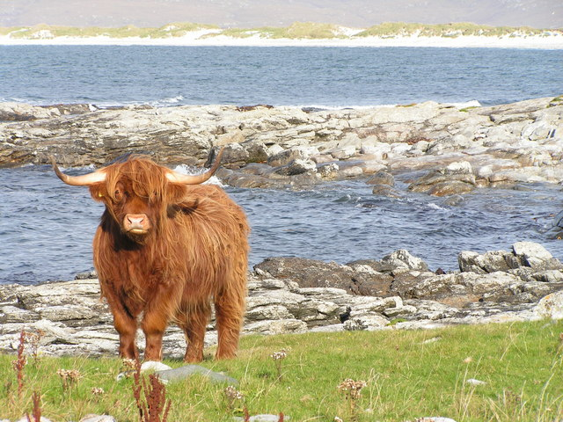
ANTH 3888
Anthropology of Food
Culture
as a
Primary Concept
University of Minnesota Duluth
Tim Roufs
© 2010-2026
http://en.wikipedia.org/wiki/Highland_cattle

Slide 4
American
Main Characteristics of˄Anthropology
1. the four fields of general anthropology
culture as a primary concept
comparative method as major approach
holism as a primary theoretical goal
fieldwork as a primary research technique

Slide 5
American
Main Characteristics of˄Anthropology
1. the four fields of general anthropology
culture as a primary concept
comparative method as major approach
holism as a primary theoretical goal
fieldwork as a primary research technique

Slide 6
Main Characteristics
“culture” is
  learned
  shared
  transmitted from generation to generation
  based on symbols
  integrated

Slide 7
Main Characteristics
“culture”
  learned
  shared
  transmitted from generation to generation
  based on symbols
  integrated
some focus on the idea that it involves
“shared understanding”

Slide 8
Main Characteristics
“culture”
    is not inherited
  (i.e., is not biological)
    is not “instinct”

Slide 9
Main Characteristics
“cultures”
    are groups of people sharing a common heritage
    (and usually a common language)

Slide 10
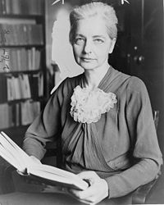
Main Characteristics
“cultures”
    are “integrated”
    -- an idea that was pioneered and emphasized by the “pioneer” anthropologist Ruth Benedict
Ruth Fulton Benedict
1887-1948
Patterns of Culture
1934

Slide 11
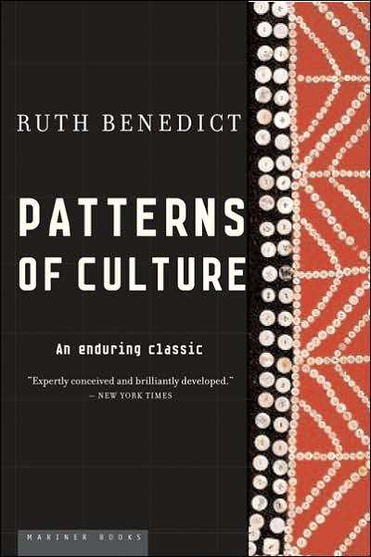
Ruth Fulton Benedict
1887-1948
Patterns of Culture
1934

Slide 12
Main Characteristics
“cultures”
    are integrated
    Interact and change
      the idea that some cultures
      (like “hunting and gathering” cultures, or the Amish)
      do not change is not correct

Slide 13
The Concept of Culture
microculture
  are smaller groups with distinct pattern of learned and shared behavior and thinking found within larger cultures such as ethnic groups in localized regions
  some people like to think of these as
  “local cultures”

Slide 14
The Concept of Culture
microculture
  are smaller groups with distinct pattern of learned and shared behavior and thinking found within larger cultures such as ethnic groups in localized regions
  some people like to think of these as
  “local cultures”

Slide 15
The Concept of Culture
microcultures can include ethnic groups within nations
  e.g., Greek-Americans
  e.g., Anishinabe (Chippewa; Ojibwa)
  e.g., Irish “Travellers”
    sometimes incorrectly called “Gypsies”
  e.g., Australian Aboriginals
  e.g., Cajun
  e.g., Rom (Gypsies)
  e.g., Basques
  e.g., Kurds

Slide 16
The Concept of Culture
microcultures can include ethnic groups within nations
  e.g., Greek-Americans
  e.g., Anishinabe (Chippewa; Ojibwa)
  e.g., Irish “Travellers”
    sometimes incorrectly called “Gypsies”
  e.g., Australian Aboriginals
  e.g., Cajun
  e.g., Rom (Gypsies)
  e.g., Basques
  e.g., Kurds
local groups generally strive to preserve their cultural identity

Slide 17
The Concept of Culture
local groups (microcultures)
generally strive to preserve their cultural identity with . . .
food
clothing
religion
ritual
music, dance, and other arts
language
cultural symbols . . .

Slide 18
The Concept of Culture
microcultures can include ethnic groups within nations
  e.g., Greek-Americans
  e.g., Anishinabe (Chippewa; Ojibwa)
  e.g., Irish “Travellers”
    sometimes incorrectly called “Gypsies”
  e.g., Australian Aboriginals
  e.g., Cajun
  e.g., Rom (Gypsies)
  e.g., Basques
  e.g., Kurds

Slide 19

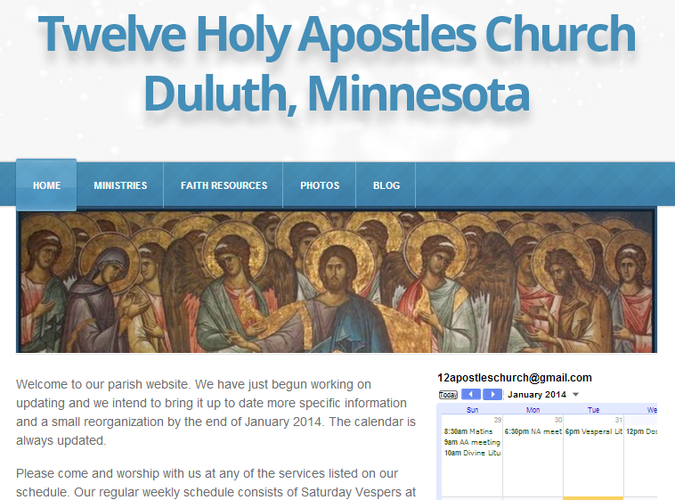
The Concept of Culture
microculture
  are smaller groups with distinct pattern of learned and shared behavior and thinking found within larger cultures such as ethnic groups in localized regions
  some people like to think of these as
  “local cultures”

Slide 20
The Concept of Culture
microculture
  are smaller groups with distinct pattern of learned and shared behavior and thinking found within larger cultures such as ethnic groups in localized regions
  some people like to think of these as
  “local cultures”
local groups generally strive to preserve their cultural identity . . .

Slide 21
The Concept of Culture
local groups (microcultures)
generally strive to preserve their cultural identity with . . .
food
clothing
religion
ritual
music, dance, and other arts
language
cultural symbols . . .

Slide 22
The Concept of Culture
local groups (microcultures)
generally strive to preserve their cultural identity with . . .
food
clothing
religion
ritual
music, dance, and other arts
language
cultural symbols . . .

Slide 23
The Concept of Culture
microcultures can include ethnic groups within nations
  e.g., Anishinabe (Chippewa; Ojibwa)
  e.g., Irish “Travellers”
    sometimes incorrectly called “Gypsies”
  e.g., Australian Aboriginals
  e.g., Cajan
  e.g., Rom (Gypsies)
  e.g., Basques
  e.g., Kurds
. . . most often
cultures and microcultures are associated with their cuisine . . .
and can sometimes even be defined by their cuisine …

Slide 24
The Concept of Culture
microcultures can include ethnic groups within nations
  e.g., Anishinabe (Chippewa; Ojibwa)
  e.g., Irish “Travellers”
    sometimes incorrectly called “Gypsies”
  e.g., Australian Aboriginals
  e.g., Cajan
  e.g., Rom (Gypsies)
  e.g., Basques
  e.g., Kurds
. . . most often
these cultures are associated with their cuisine . . .
and can sometimes even be defined by their cuisine …
and they sometimes can even be defined by their cuisine . . .

Slide 25
The Concept of Culture
microcultures can include ethnic groups within nations
  e.g., Anishinabe (Chippewa; Ojibwa)
  e.g., Irish “Travellers”
    sometimes incorrectly called “Gypsies”
  e.g., Australian Aboriginals
  e.g., Cajan
  e.g., Rom (Gypsies)
  e.g., Basques
  e.g., Kurds
. . . and one’s cuisine is often a key factor in one’s own individual and collective identity . . .

Slide 26
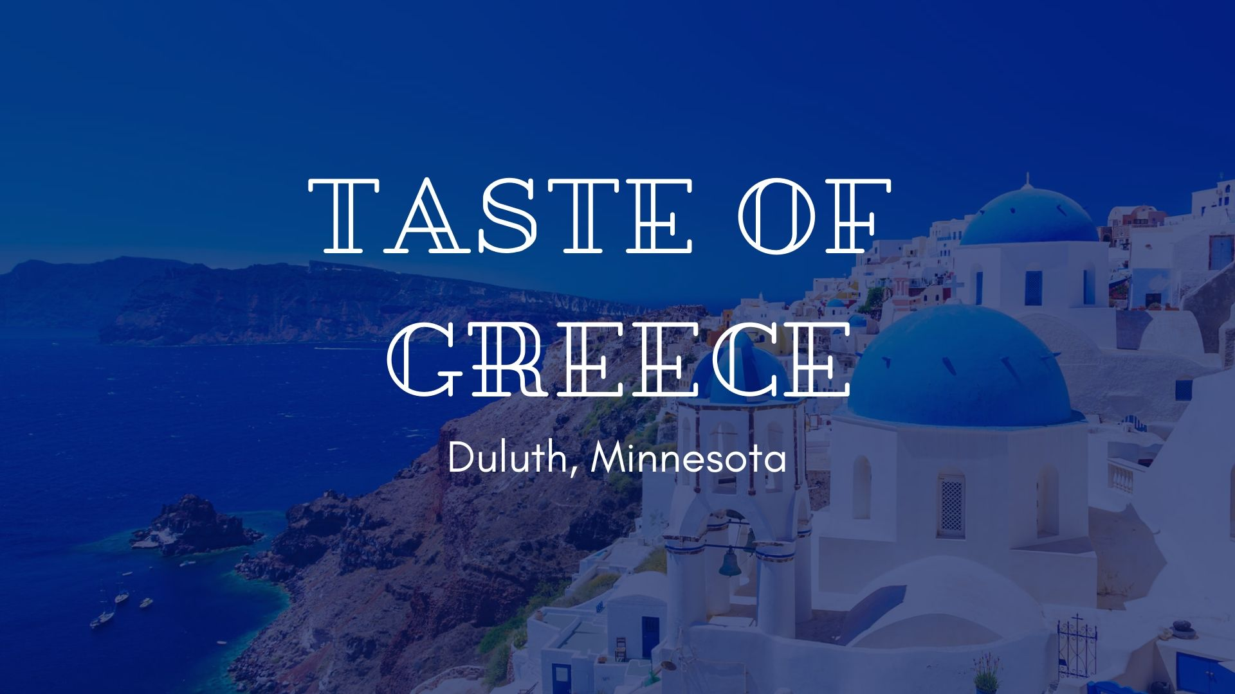

Slide 27
A Taste of Greece
34th Annual Food Festival 2026

Slide 28
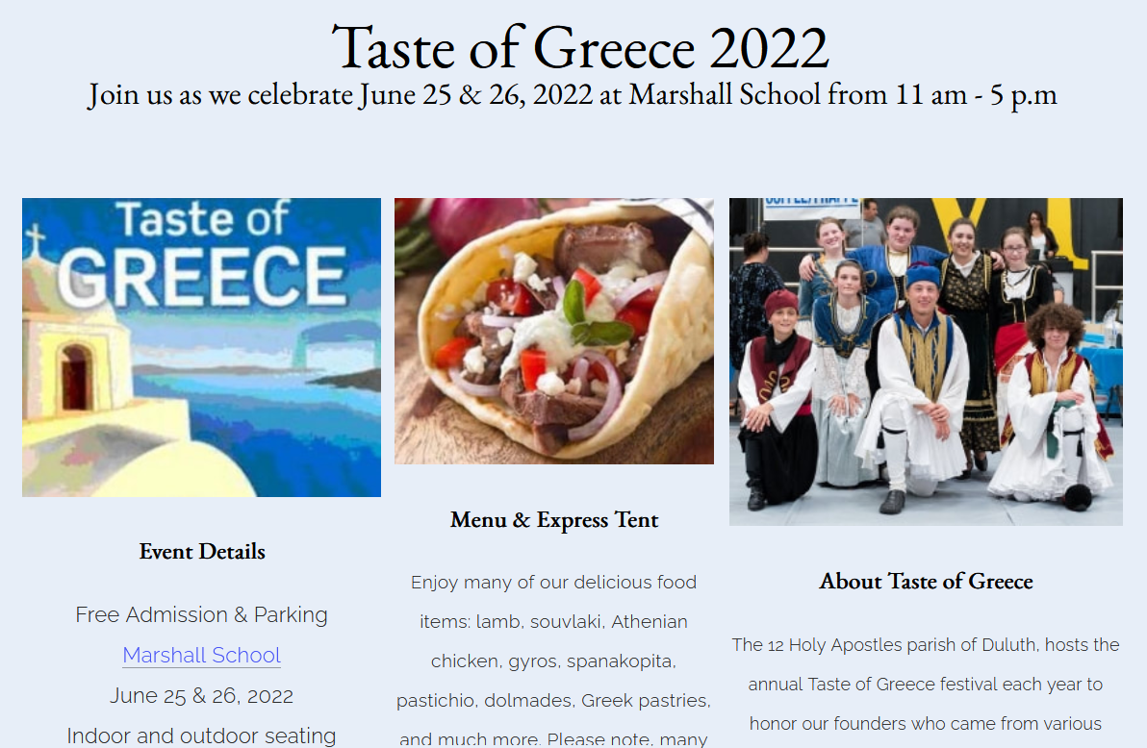
A Taste of Greece 2026
34th Annual Food Festival 2026

Slide 29
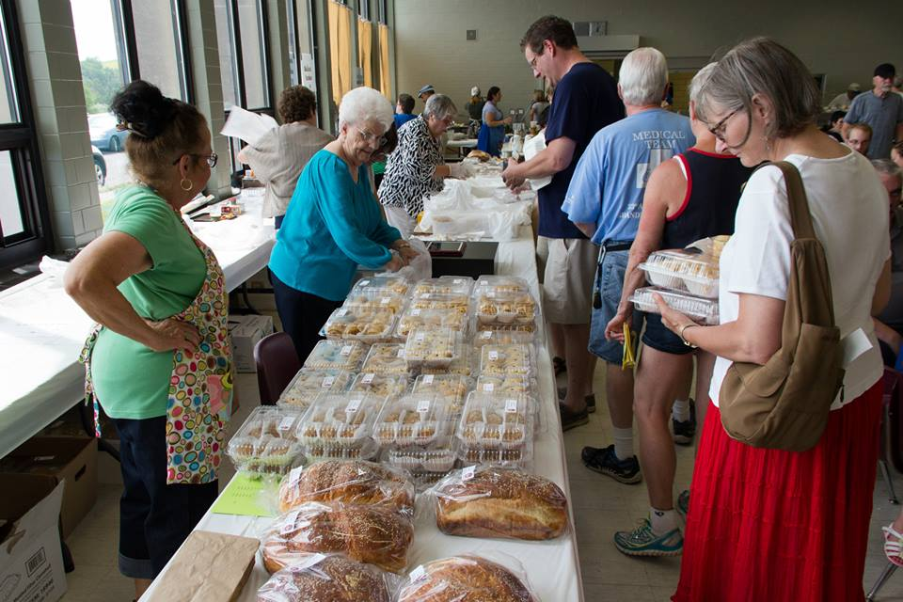
www.facebook.com/alexganeevphotography/photos/

Slide 30
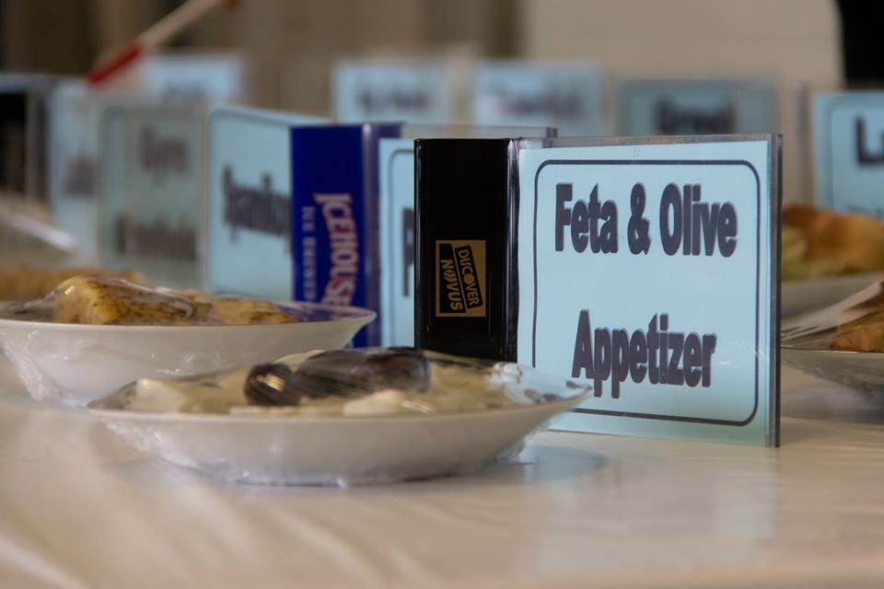
www.facebook.com/alexganeevphotography/photos/

Slide 31
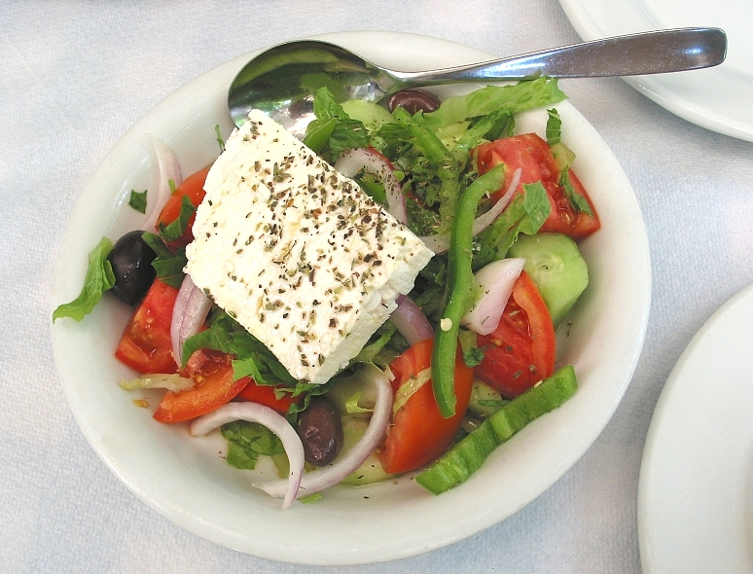
“Greek Salad”
“Farmer’s Salad”

Slide 32
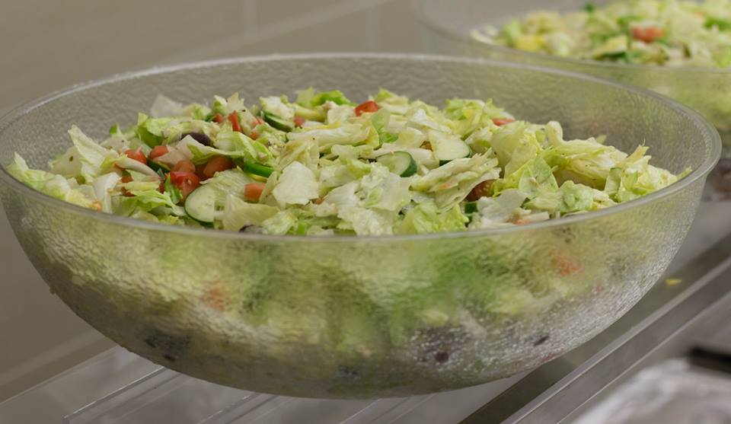
“Greek Salad”
“Farmer’s Salad”
www.facebook.com/alexganeevphotography/photos/

Slide 33
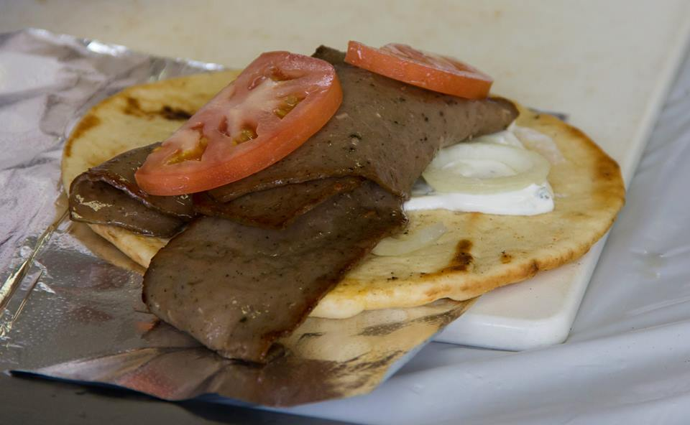
Gyro
gyro
www.facebook.com/alexganeevphotography/photos/

Slide 34
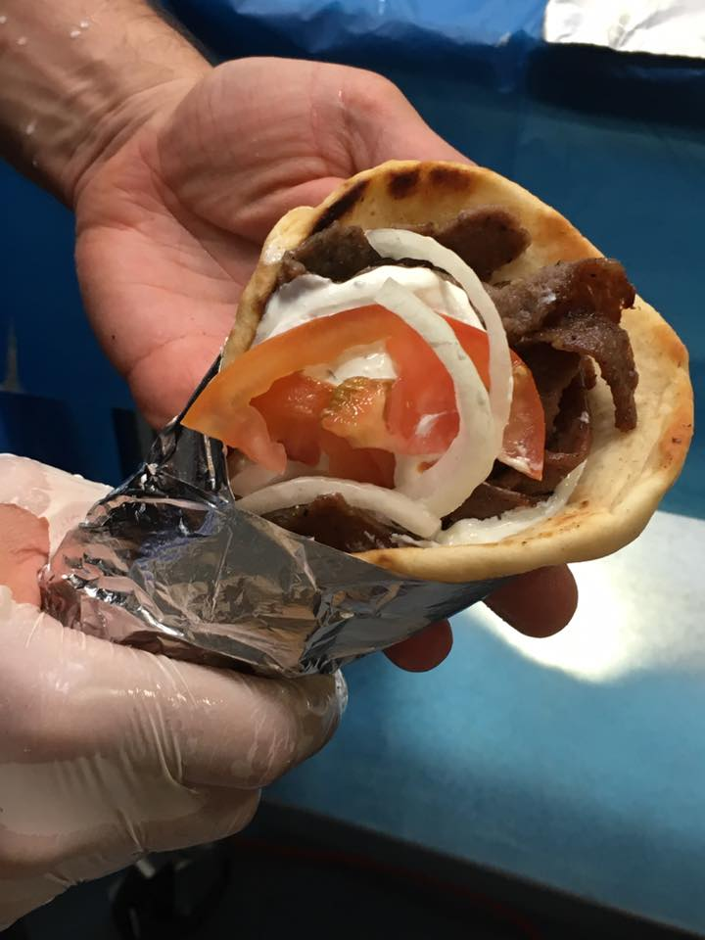
gyro
A Tate of Greece
25th Annual Food Festival 2017

Slide 35
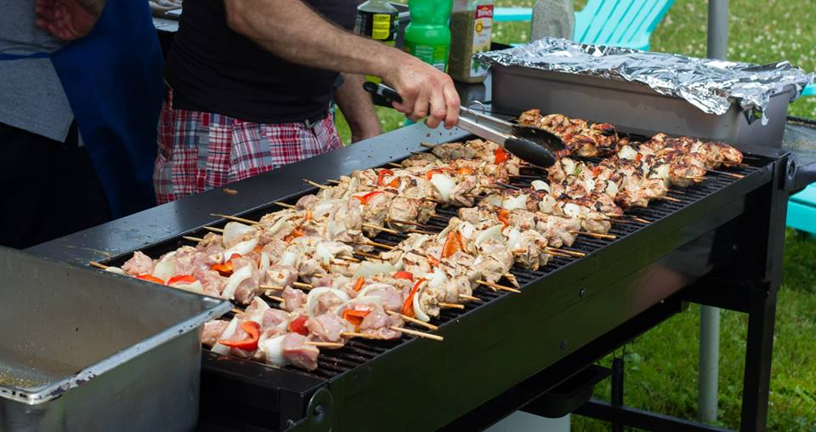
souvlaki
www.facebook.com/alexganeevphotography/photos/

Slide 36
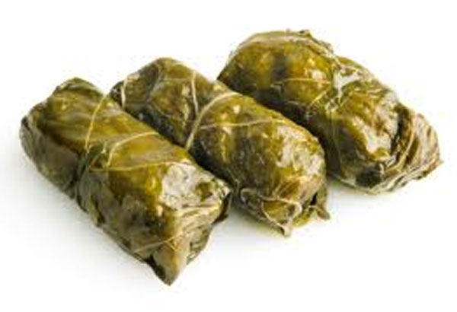
dolmathes

Slide 37
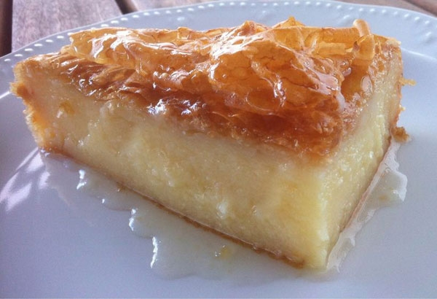
galaktoboureko

Slide 38
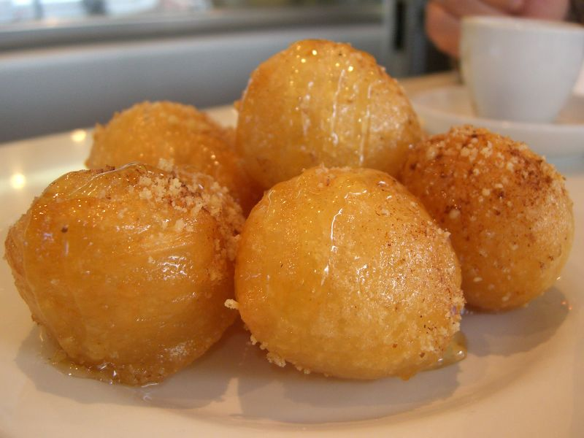
loukoumades

Slide 39
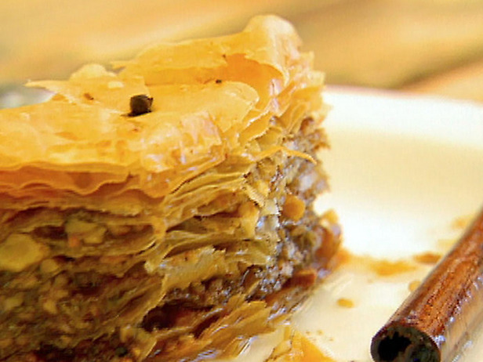
baklava

Slide 40
Greek baklava

Slide 41
dimond-shaped
with a whole clove
and no pistachios
Greek baklava

Slide 42
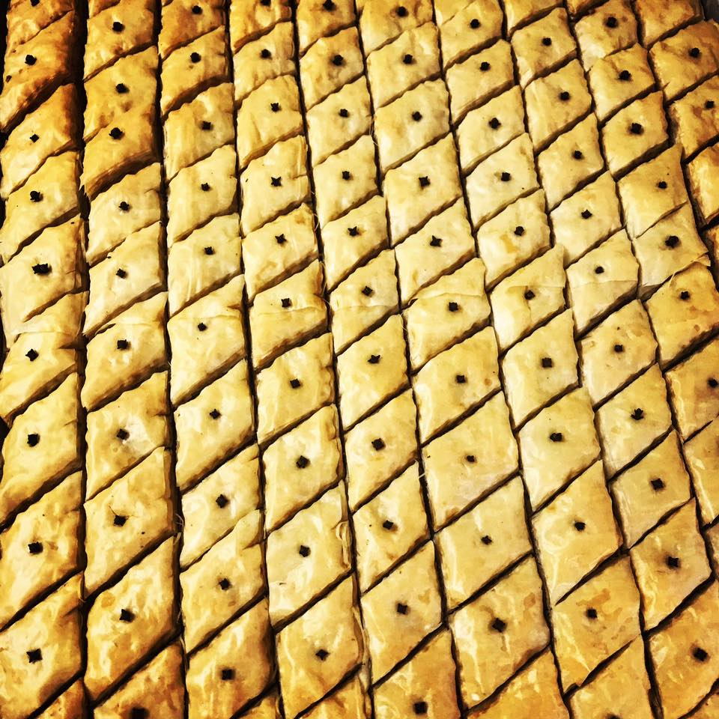
cut diamond-shaped
then served with a whole clove
A Tate of Greece
25th Annual Food Festival 2017

Slide 43
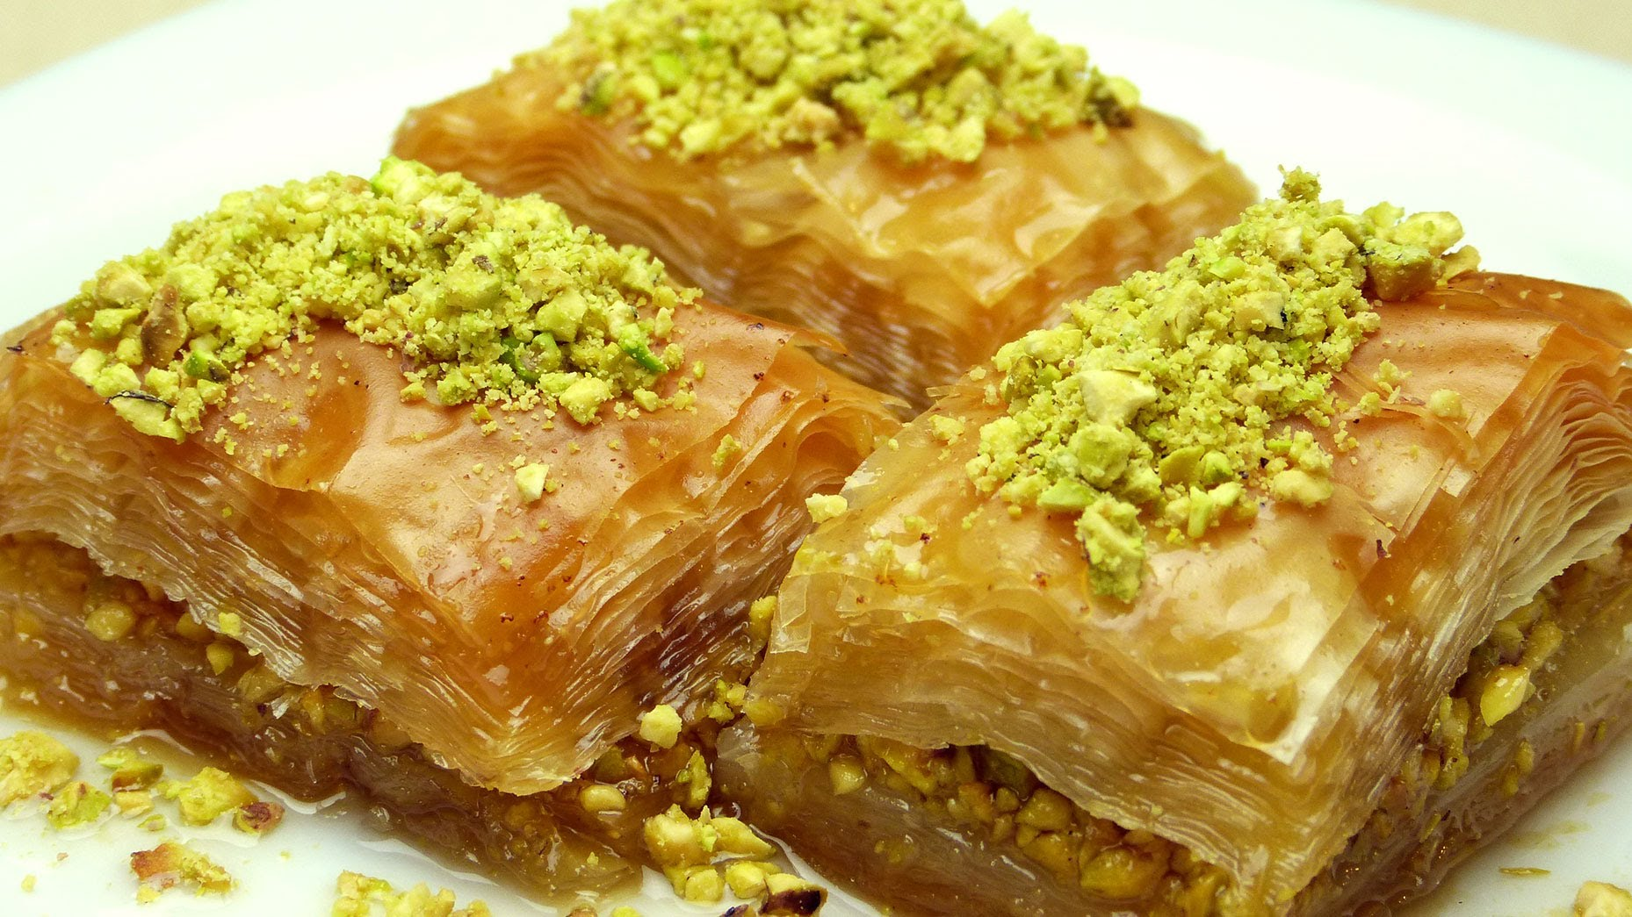
with pistachios
Turkish baklava

Slide 44
Turkish baklava

Slide 45
rectangular
and often with pistachios
Turkish baklava

Slide 46
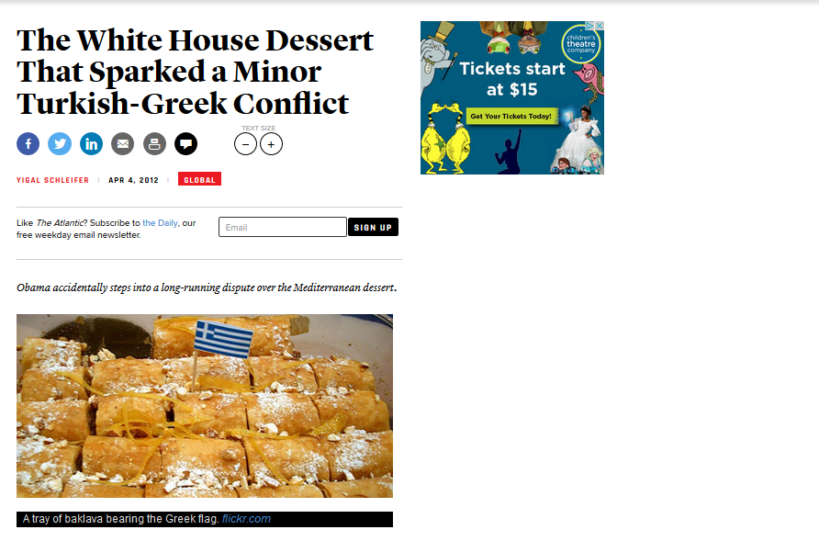
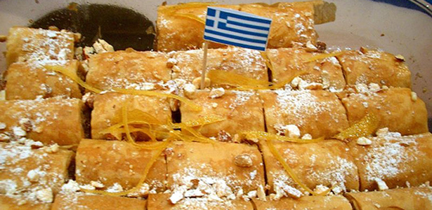
http://www.theatlantic.com/international/archive/2012/04/the-white-house-dessert-that-sparked-a-minor-turkish-greek-conflict/255439/

Slide 47
Greek flag
Turkish baklava
http://www.theatlantic.com/international/archive/2012/04/the-white-house-dessert-that-sparked-a-minor-turkish-greek-conflict/255439/

Slide 48
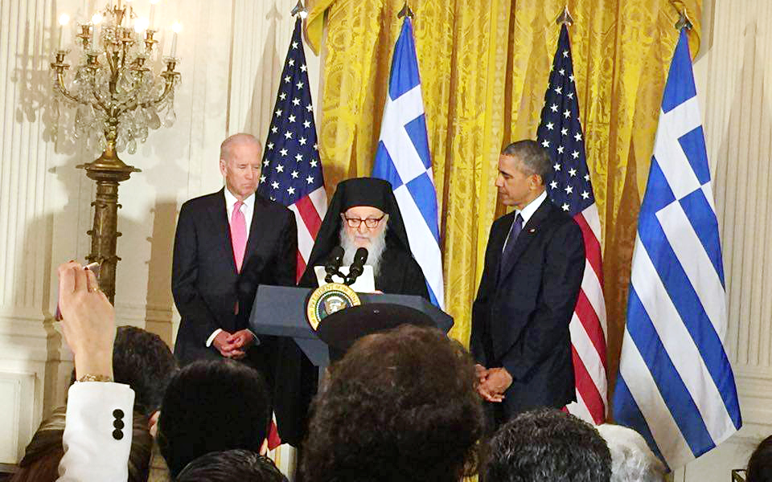
http://www.theatlantic.com/international/archive/2012/04/the-white-house-dessert-that-sparked-a-minor-turkish-greek-conflict/255439/

Slide 49

“baklava wars”
http://www.d.umn.edu/cla/faculty/troufs/anthfood/SweetTreats.html#title

Slide 50
http://www.d.umn.edu/cla/faculty/troufs/anthfood/SweetTreats.html#title

Slide 51
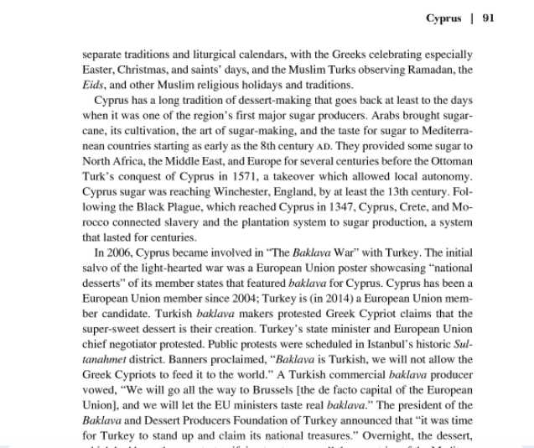
“baklava wars”
http://www.d.umn.edu/cla/faculty/troufs/anthfood/SweetTreats.html#title

Slide 52
dimond-shaped
with a whole clove
and no pistachios
Greek baklava

Slide 53
rectangular
and often with pistachios
Turkish baklava

Slide 54
http://www.theatlantic.com/international/archive/2012/04/the-white-house-dessert-that-sparked-a-minor-turkish-greek-conflict/255439/

Slide 55
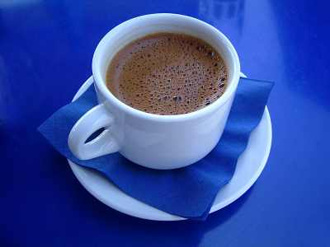
Ellinikos Kafes
http://www.ultimate-guide-to-greek-food.com/greek-coffee.html

Slide 56
Greek coffee?
http://www.ultimate-guide-to-greek-food.com/greek-coffee.html

Slide 57
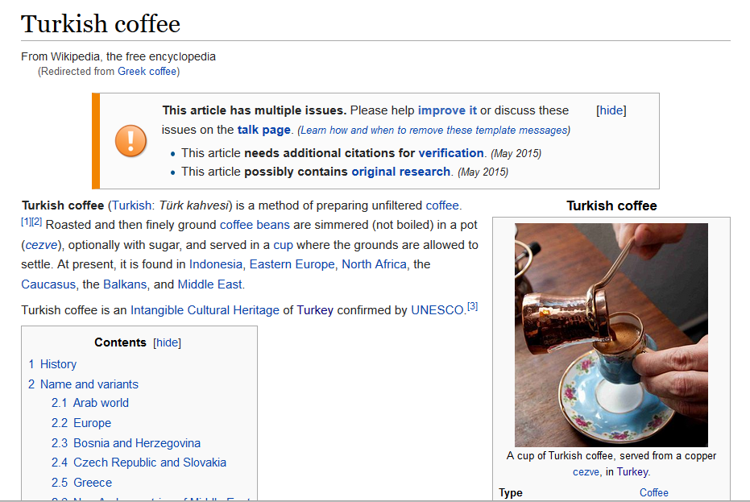

https://en.wikipedia.org/wiki/Turkish_coffee

Slide 58
https://en.wikipedia.org/wiki/Turkish_coffee

Slide 59
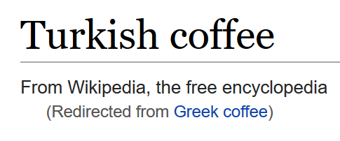
https://en.wikipedia.org/wiki/Turkish_coffee

Slide 60
https://en.wikipedia.org/wiki/Turkish_coffee

Slide 61

https://en.wikipedia.org/wiki/Turkish_coffee

Slide 62
The Concept of Culture
local groups (microcultures)
generally strive to preserve their cultural identity with . . .
food
clothing
religion
ritual
music, dance, and other arts
language
cultural symbols . . .

Slide 63
The Concept of Culture
local groups (microcultures)
generally strive to preserve their cultural identity with . . .
food
clothing
religion
ritual
music, dance, and other arts
language
cultural symbols . . .

Slide 64
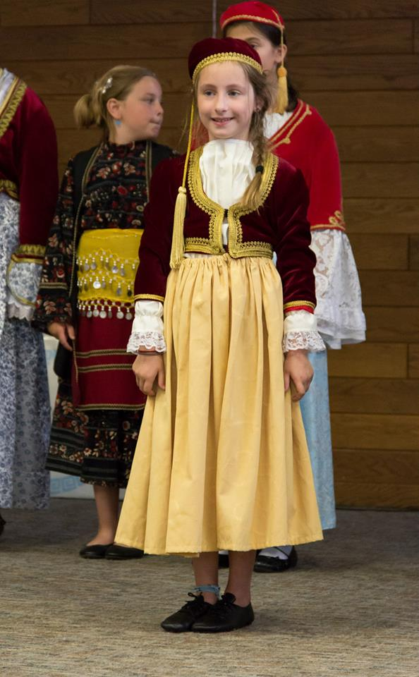
www.facebook.com/alexganeevphotography/photos/

Slide 65
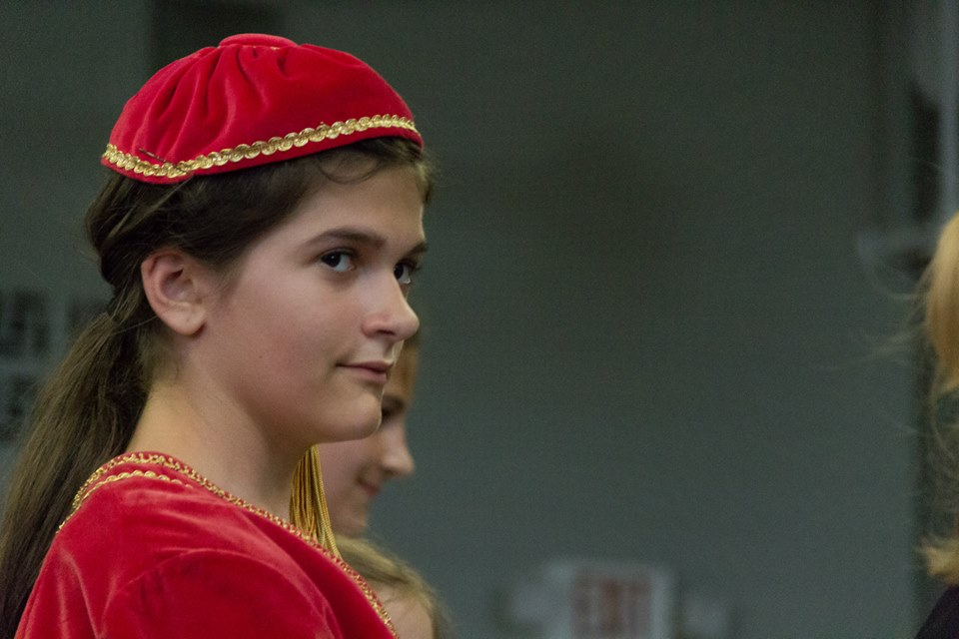
www.facebook.com/alexganeevphotography/photos/

Slide 66
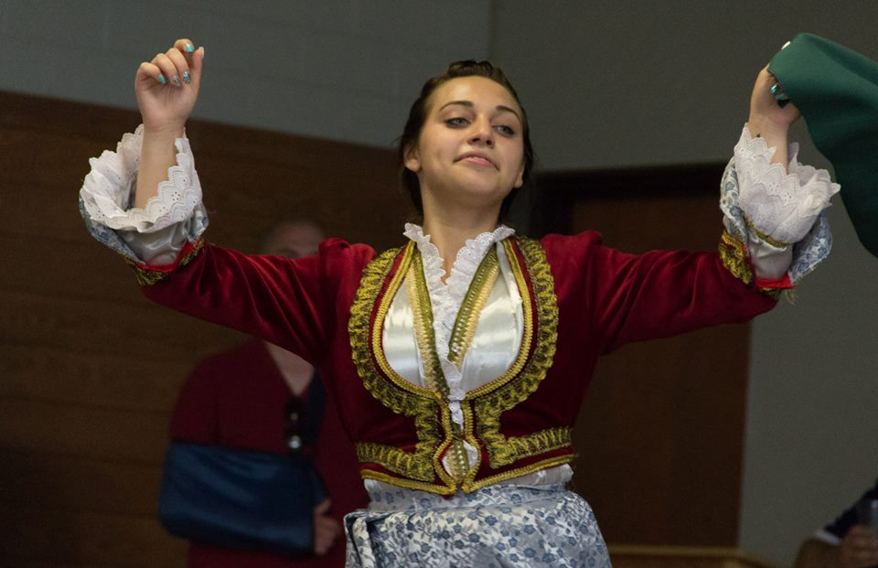
www.facebook.com/alexganeevphotography/photos/

Slide 67
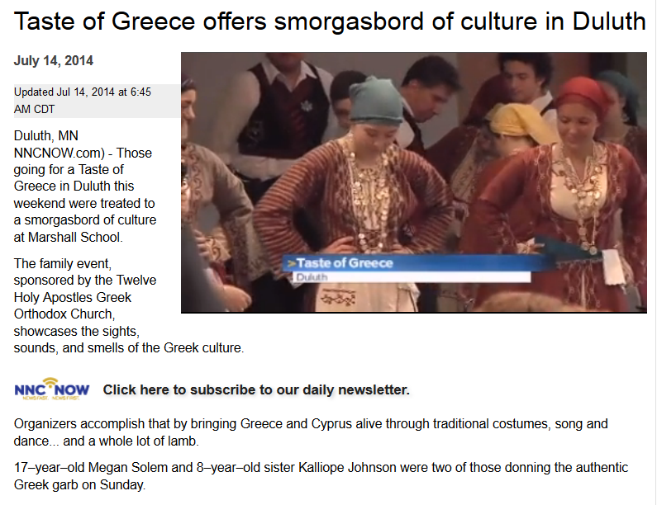
A Taste of Greece
22nd Annual Food Festival 2014

Slide 68
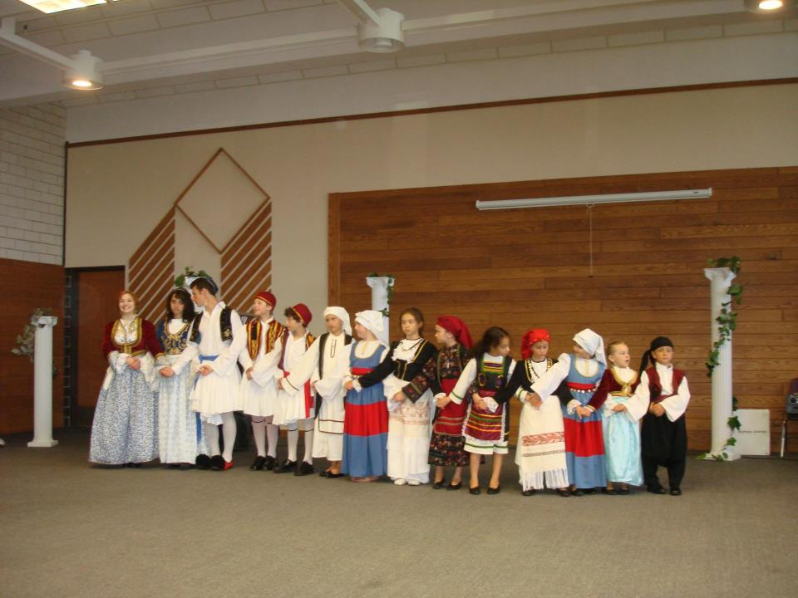
A Taste of Greece
22nd Annual Food Festival 2014
https://www.facebook.com/pages/Taste-of-Greece-Festival-Duluth-Minnesota/199921043362252

Slide 69
The Concept of Culture
local groups (microcultures)
generally strive to preserve their cultural identity with . . .
food
clothing
religion
ritual
music, dance, and other arts
language
cultural symbols . . .

Slide 70
The Concept of Culture
local groups (microcultures)
generally strive to preserve their cultural identity with . . .
food
clothing
religion
ritual
music, dance, and other arts
language
cultural symbols . . .

Slide 72
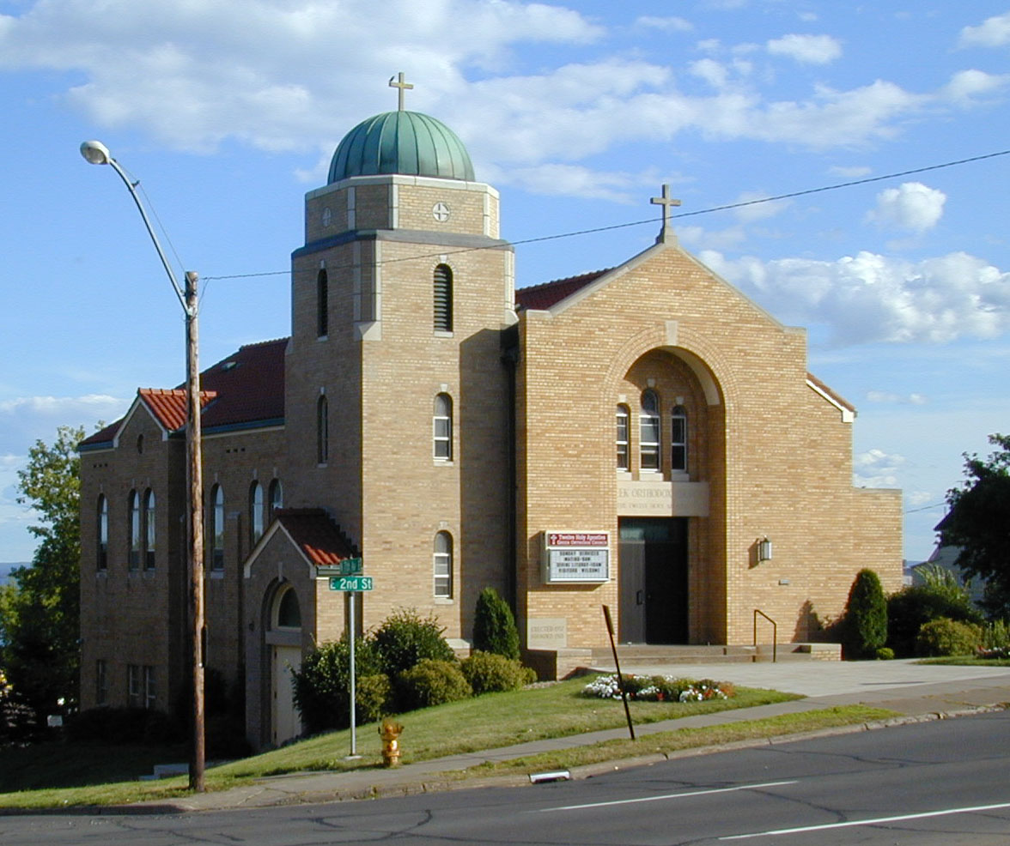
https://www.facebook.com/pages/Taste-of-Greece-Festival-Duluth-Minnesota/199921043362252

Slide 73
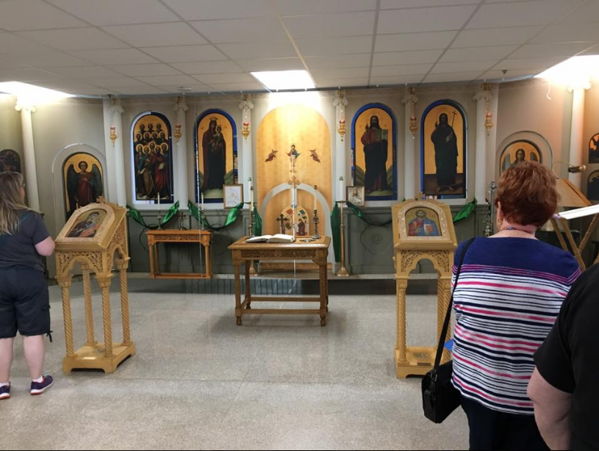
The Taste of Greece Festival, Duluth, MN, 2017

Slide 74
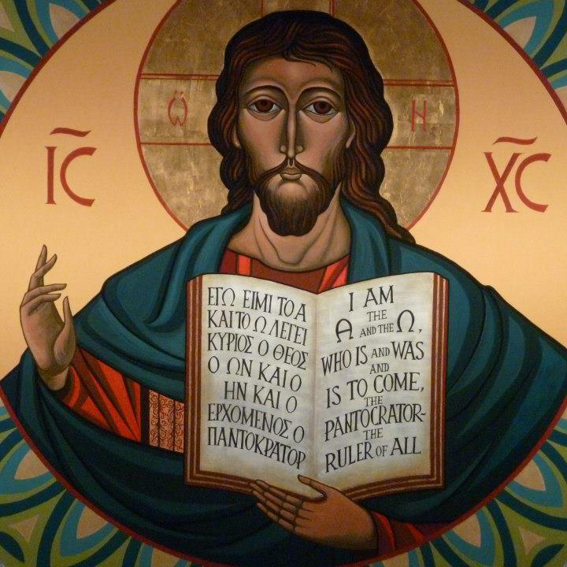
https://www.facebook.com/12HolyApostlesChurch/photos/

Slide 75
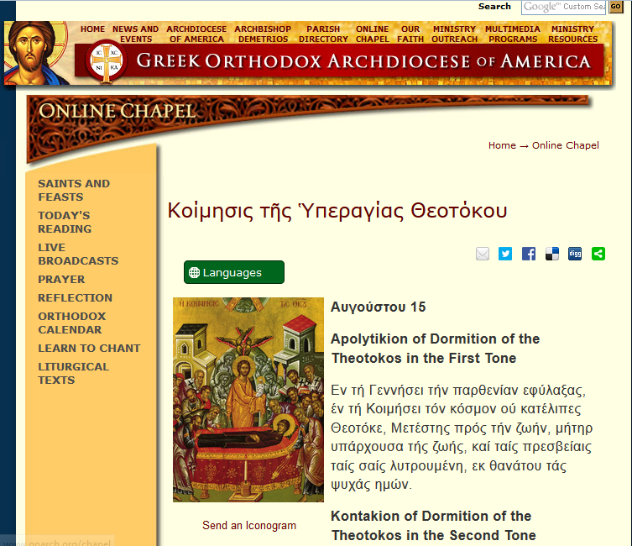
http://www.goarch.org/chapel/saints_view?contentid=165&date=8/15/2015&D=SA&language=el

Slide 76
The Concept of Culture
local groups (microcultures)
generally strive to preserve their cultural identity with . . .
food
clothing
religion
ritual
music, dance, and other arts
language
cultural symbols . . .

Slide 77
The Concept of Culture
local groups (microcultures)
generally strive to preserve their cultural identity with . . .
food
clothing
religion
ritual
music, dance, and other arts
language
cultural symbols . . .

Slide 78
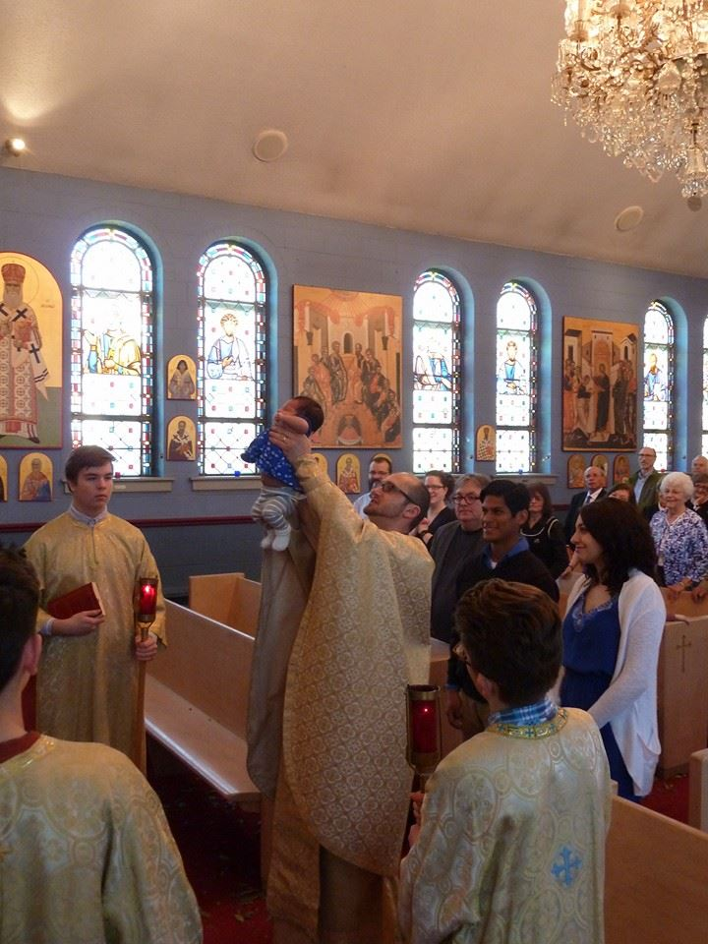
www.facebook.com/alexganeevphotography/photos/

Slide 79
The Concept of Culture
local groups (microcultures)
generally strive to preserve their cultural identity with . . .
food
clothing
religion
ritual
music, dance, and other arts
language
cultural symbols . . .

Slide 80
The Concept of Culture
local groups (microcultures)
generally strive to preserve their cultural identity with . . .
food
clothing
religion
ritual
music, dance, and other arts
language
cultural symbols . . .

Slide 81
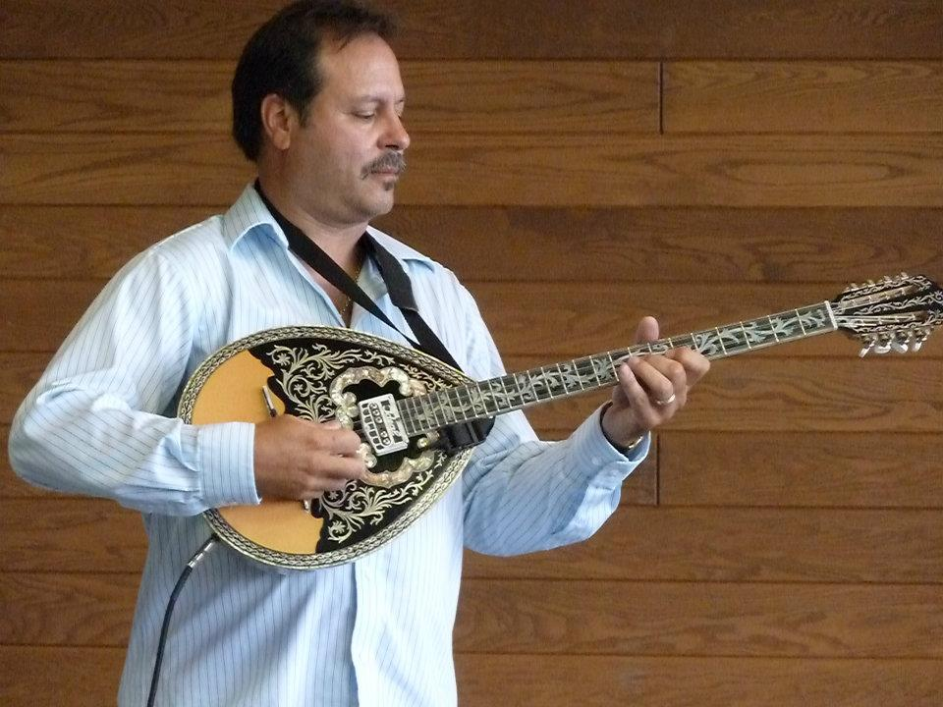
A Taste of Greece
22nd Annual Food Festival 2014
https://www.facebook.com/pages/Taste-of-Greece-Festival-Duluth-Minnesota/199921043362252

Slide 82
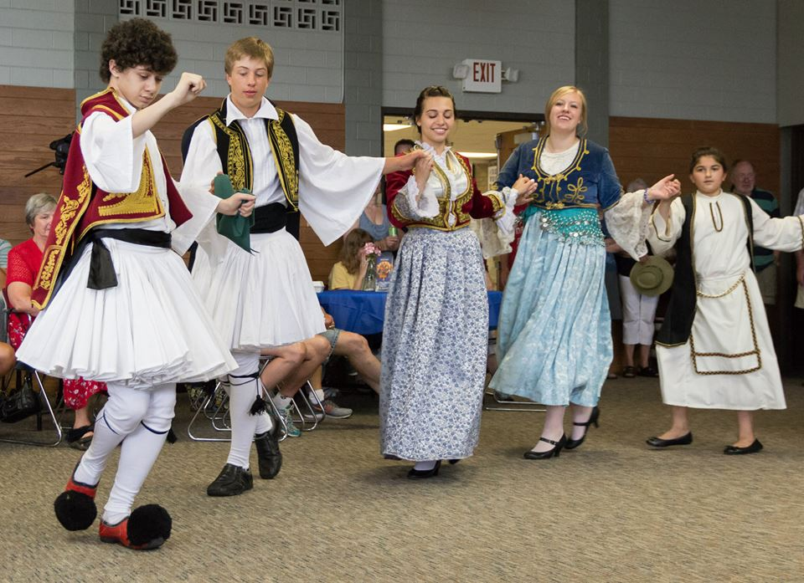
www.facebook.com/alexganeevphotography/photos/

Slide 83
The Concept of Culture
local groups (microcultures)
generally strive to preserve their cultural identity with . . .
food
clothing
religion
ritual
music, dance, and other arts
language
cultural symbols . . .
and in Greek communities
there’s ALWAYS

Slide 84
www.facebook.com/alexganeevphotography/photos/

Slide 85
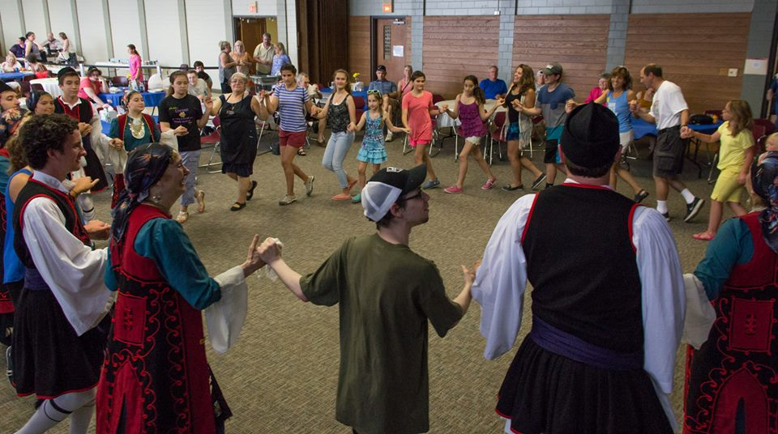

Slide 86
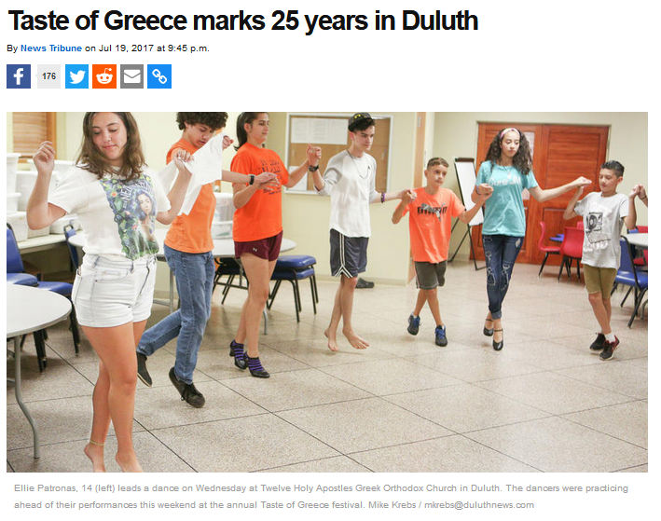
. . . now 27 years . . .
A Tate of Greece
23nd Annual Food Festival 2015
http://www.duluthnewstribune.com/news/4300249-taste-greece-marks-25-years-duluth

Slide 87
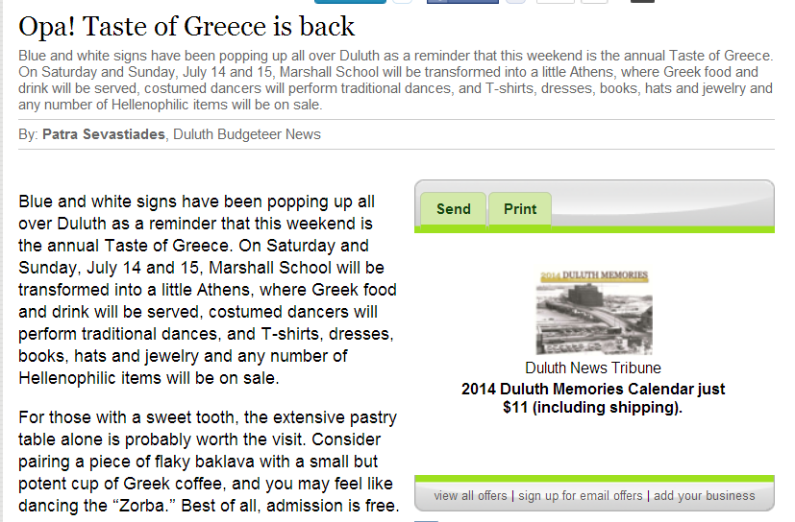
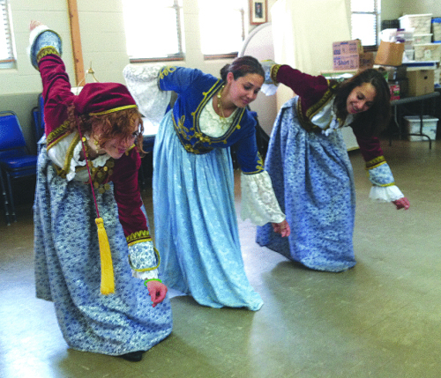
A Taste of Greece
22nd Annual Food Festival 2014
The “Zorba” begins with a low sweeping motion. Eva Sevastiades, 19, Megan Solem, 15, and Tess Sevastiades, 15, start to dance.
(Photo by Patra Sevastiades)

Slide 88
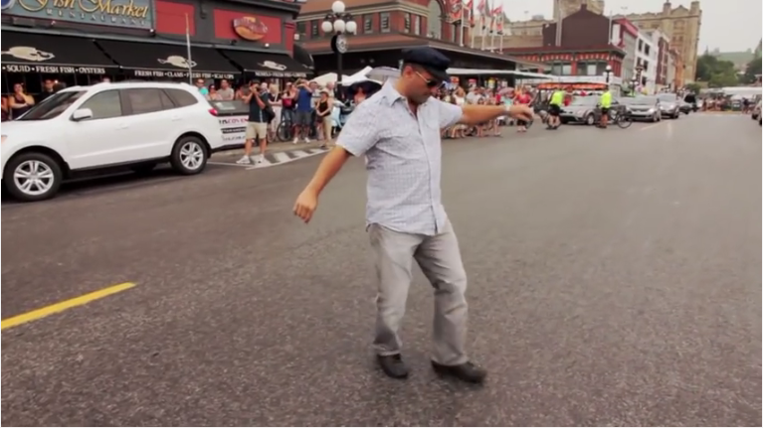

. . . 5:00
Ottawa Greek Festival (GreekFest)
https://www.youtube.com/watch?v=UhDgpXWkFHE

Slide 89
watch this short video
. . . 5:00
Ottawa Greek Festival (GreekFest)
https://www.youtube.com/watch?v=UhDgpXWkFHE

Slide 90
Watch this short video
(8:07 min.)
It says a lot about Greek culture
and about festivals
https://www.youtube.com/wa8:07tch?v=UhDgpXWkFHE
. . . 5:00
Ottawa Greek Festival (GreekFest)
https://www.youtube.com/watch?v=UhDgpXWkFHE

Slide 91
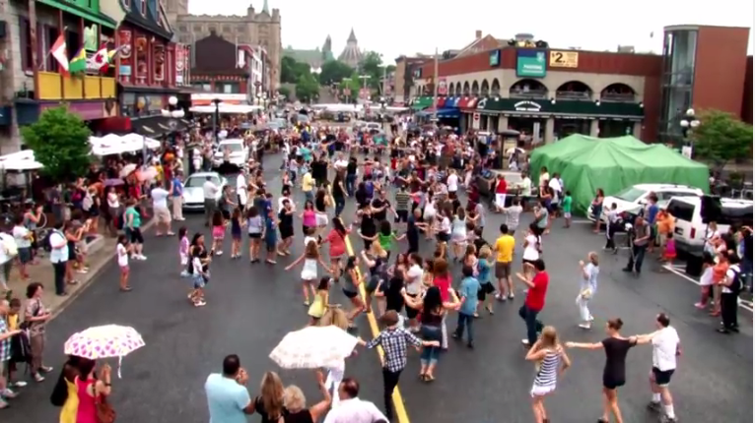
. . . 5:00
Ottawa Greek Festival (GreekFest)
https://www.youtube.com/watch?v=UhDgpXWkFHE

Slide 92
The Concept of Culture
local groups (microcultures)
generally strive to preserve their cultural identity with . . .
food
clothing
religion
ritual
fine arts
language
cultural symbols . . .

Slide 93
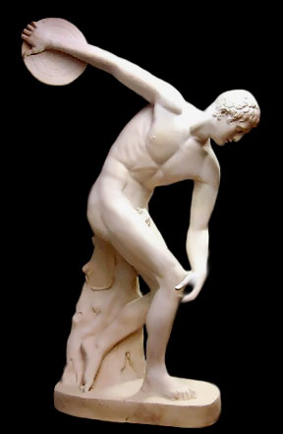
Discus Thrower
ca. 460 B.C.
http://www.crystalinks.com/greekart.html

Slide 94
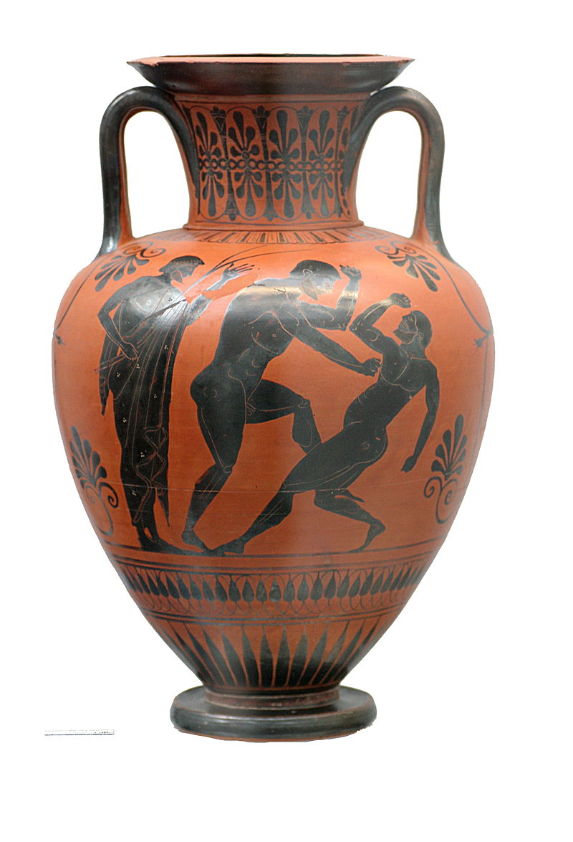
Black figure Amphora
Atalante painter
500-490 B.C.
https://en.wikipedia.org/wiki/Ancient_Greek_architecture#/media/File:Boxers_Staatliche_Antikensammlungen_1541.jpg

Slide 95
The Concept of Culture
local groups (microcultures)
generally strive to preserve their cultural identity with . . .
food
clothing
religion
ritual
architecture
(sometimes)
language
cultural symbols . . .

Slide 96
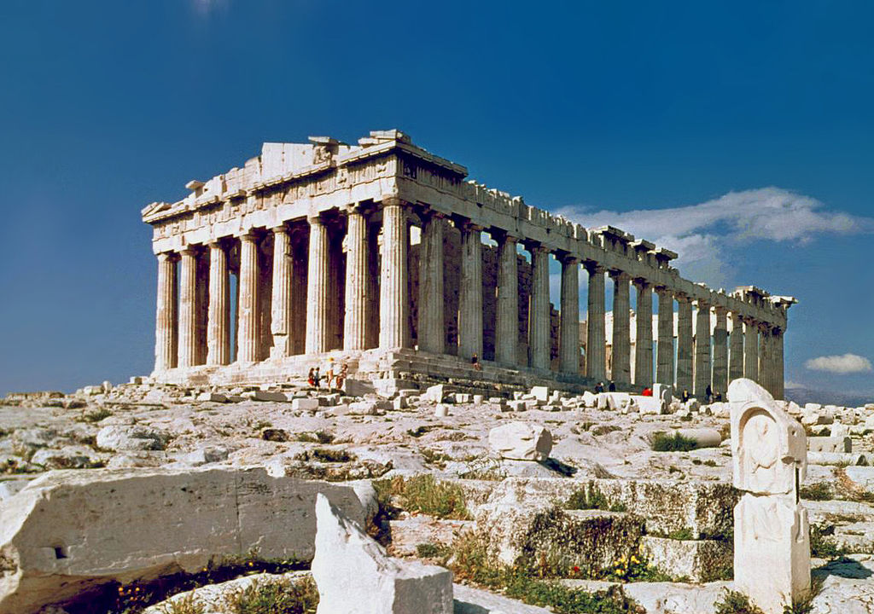
https://en.wikipedia.org/wiki/Ancient_Greek_architecture#/media/File:O_Partenon_de_Atenas.jpg

Slide 97
The Concept of Culture
local groups (microcultures)
generally strive to preserve their cultural identity with . . .
food
clothing
religion
ritual
music, dance, and other arts
language
cultural symbols . . .

Slide 98
The Concept of Culture
local groups (microcultures)
generally strive to preserve their cultural identity with . . .
food
clothing
religion
ritual
music, dance, and other arts
language
cultural symbols . . .

Slide 99
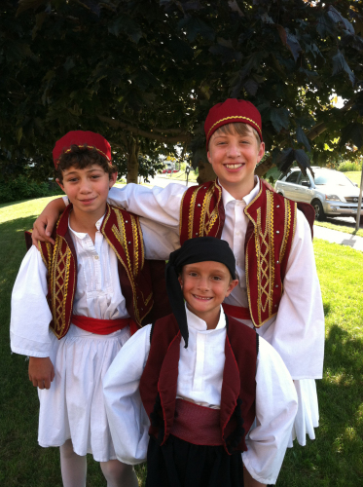
names
A Taste of Greece
22nd Annual Food Festival 2014
Dima Sevastiades, Styli Regas and Demetri Bush wear their dance costumes for the Taste of Greece.
(Photo by Patra Sevastiades)

Slide 100
even the names often reinforce one’s cultural identity
A Taste of Greece
22nd Annual Food Festival 2014
Dima Sevastiades, Styli Regas and Demetri Bush wear their dance costumes for the Taste of Greece.
(Photo by Patra Sevastiades)

Slide 101
A Taste of Greece
22nd Annual Food Festival 2014
Dima Sevastiades, Styli Regas and Demetri Bush wear their dance costumes for the Taste of Greece.
(Photo by Patra Sevastiades)

Slide 102
http://www.goarch.org/chapel/saints_view?contentid=165&date=8/15/2015&D=SA&language=el

Slide 103
https://www.facebook.com/12HolyApostlesChurch/photos/

Slide 104
The Concept of Culture
local groups (microcultures)
generally strive to preserve their cultural identity with . . .
food
clothing
religion
ritual
music, dance, and other arts
language
cultural symbols . . .

Slide 105
The Concept of Culture
local groups (microcultures)
generally strive to preserve their cultural identity with . . .
food
clothing
religion
ritual
music, dance, and other arts
language
cultural symbols . . .

Slide 106


Slide 107
including colors

Slide 108
“Greek Coffee”

Slide 109
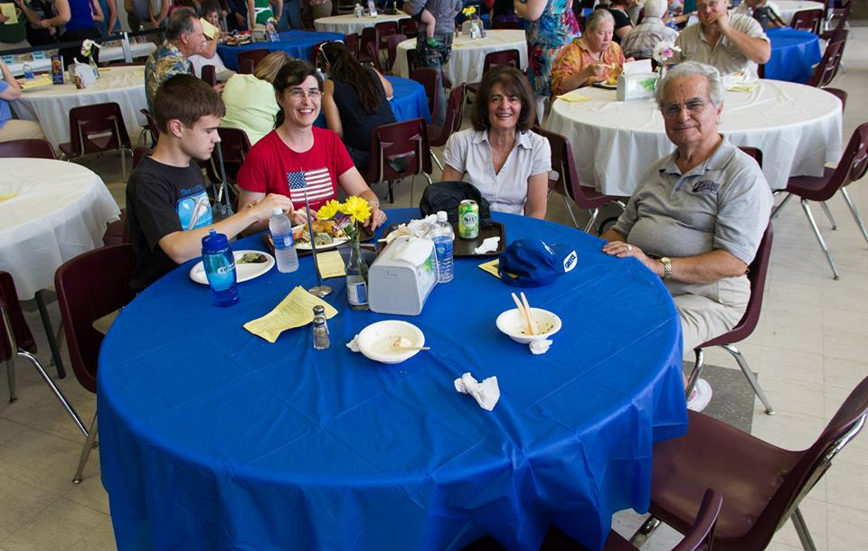
https://www.facebook.com/alexganeevphotography/photos/

Slide 110
The Concept of Culture
local groups (microcultures)
generally strive to preserve their cultural identity with . . .
food
clothing
religion
ritual
music, dance, and other arts
language
cultural symbols . . .
and these can be combined . . .

Slide 111

and these features are common
In Greek communities . . .
Greek Festivals are common wherever Greeks reside . . .

Slide 112
religion
language
art
symbols
https://www.facebook.com/12HolyApostlesChurch/photos/

Slide 113
food
religion
symbols
Greek baklava

Slide 114
clothing
music
dance
symbols,
(including “Zorba”)
A Taste of Greece
22nd Annual Food Festival 2014
The “Zorba” begins with a low sweeping motion. Eva Sevastiades, 19, Megan Solem, 15, and Tess Sevastiades, 15, start to dance.
(Photo by Patra Sevastiades)

Slide 115
The Concept of Culture
local groups (microcultures)
there are many microcultures . . .
and . . .

Slide 116
The Concept of Culture
local groups (microcultures)
generally strive to preserve their cultural identity with . . .
food
clothing
religion
ritual
music, dance, and other arts
language
cultural symbols . . .

Slide 117

Montgomery, Minnesota

Slide 118

Montgomery Minnesota
Celebrates its
Czech Heritage
Montgomery, Minnesota
Kolacky Days Festival, est. 1929

Slide 119

Czech
Montgomery, Minnesota
Kolacky Days Festival, est. 1929

Slide 120

Czech
Montgomery, Minnesota
Kolacky Days Festival, est. 1929

Slide 121

Montgomery, Minnesota
http://www.montgomerymn.org/

Slide 122

Montgomery, Minnesota
http://www.montgomerymn.org/

Slide 123

Montgomery, Minnesota
http://www.montgomerymn.org/

Slide 124

Montgomery, Minnesota
http://www.montgomerymn.org/

Slide 125

Montgomery, Minnesota
http://www.montgomerymn.org/

Slide 126

Montgomery, Minnesota
http://www.montgomerymn.org/

Slide 127

Montgomery, Minnesota
http://www.montgomerymn.org/

Slide 128

Montgomery, Minnesota
http://www.montgomerymn.org/

Slide 129

Montgomery, Minnesota
http://www.montgomerymn.org/

Slide 130

Montgomery, Minnesota
http://www.montgomerymn.org/

Slide 131

Montgomery, Minnesota
http://www.montgomerymn.org/

Slide 132

Montgomery, Minnesota
http://www.montgomerymn.org/

Slide 133

Budejovice Church
(St. John's Chapel)
Montgomery, Minnesota
https://fleetingfarms.wordpress.com/2014/06/25/budejovice-church-montgomery-minnesota/

Slide 134

https://www.czechheritageclub.com/

Slide 135

https://www.c8zechheritageclub.com/PDF-Files/StNick-23-full.pdf

Slide 136

https://www.montgomerymn.org/masopust/

Slide 137

“Dvořák or Dvorak is a common Czech surname, originally referring to a rich landowner with a manor house
(Czech dvůr. . . .)
It is the fourth most common surname in the Czech lands.” -- Wikipedia
Montgomery, Minnesota
Kolacky Days Festival, est. 1929

Slide 138
Motto:
Vitáme Vás
"We welcome you"
Montgomery, Minnesota
Kolacky Days Festival, est. 1929

Slide 139
The Concept of Culture
local groups (microcultures)
there are many microcultures . . .
for example . . .

Slide 140

Ely, Minnesota

Slide 141

A "Taste of Slovenia" Event Branch 23 Ely, Minnesota
Notes:
141

Slide 142

potica
featured in
Greenwood Press
31 May 2018
Notes:
142

Slide 143

Slovenia
http://www.duluthbudgeteer.com/community/4121672-simple-cooking-leads-success
Notes:
143

Slide 144
Slovenia
potica, a Slovenian treat
http://www.duluthbudgeteer.com/community/4121672-simple-cooking-leads-success
Notes:
144

Slide 145

potica
Notes:
145

Slide 146


Sevnica, Slovenia
https://www.washingtonpost.com/news/in-sight/wp/2017/06/19/inside-melania-trumps-home-town/?utm_term=.f78c5c044104
Notes:
146

Slide 147

hometown of
Melania Knauss Trump
https://www.washingtonpost.com/news/in-sight/wp/2017/06/19/inside-melania-trumps-home-town/?utm_term=.f78c5c044104
Notes:
147

Slide 148

Melania Knauss Trump
https://commons.wikimedia.org/wiki/File:Melania_Trump_Official_Portrait.jpg
Notes:
148

Slide 149
Duluth, Minnesota

Slide 150


Slide 151


Slide 152

Salolampi, the Concordia Finnish Language, Near Bemidji, MN
https://www.concordialanguagevillages.org/languages/finnish
Notes:
152

Slide 153


Slide 154

Sign in Scandia, MN.
Swedish Cultural Society of Duluth
Notes:
154

Slide 155


Finland
Duluthian Beatrice Ojakangas inducted into the Scandinavian-American Hall of Fame
http://www.duluthbudgeteer.com/community/4121672-simple-cooking-leads-success
Notes:
155

Slide 156

https://www.swedishculturalsociety.org/lucia
Notes:
156

Slide 157

Swedish Cultural Society of Duluth
Notes:
157

Slide 158


Sweden
http://www.duluthnewstribune.com/pursuits/scrapbook/3895745-linnea-hinkel-chosen-santa-lucia
Notes:
158

Slide 159

Sweden
https://www.facebook.com/Swedishculturalsociety/
Notes:
159

Slide 160

Sweden
https://www.facebook.com/Swedishculturalsociety/
Notes:
160

Slide 161

Sweden
2023 Lucia Greta Jablonski
Swedish Cultural Society of Duluth
https://www.facebook.com/Swedishculturalsociety/
Notes:
161

Slide 162

Sweden
https://www.facebook.com/p/Sami-Cultural-Center-of-North-America-100064257266401/
Notes:
162

Slide 163

Sweden
Alison Aune, 2020
“Swedish Immigration Paintings” Gammelgården Museum .
Swedish Cultural Society of Duluth
https://www.facebook.com/Swedishculturalsociety/photos
Notes:
163

Slide 164

Sweden
Sjölunden, the Concordia Swedish Language, Near Bemidji, MN
https://www.concordialanguagevillages.org/languages/swedish
Notes:
164

Slide 165


http://www.samiculturalcenter.org/
Notes:
165

Slide 166
Sami Cultural Center of North America
Lakeside Professional Building
4915 E Superior St, Duluth, MN 55804, USA
http://www.samiculturalcenter.org/
Notes:
166

Slide 167
Here’s the current status of the Sami Cultural Center in Duluth, MN (According to CoPilot, 29 December 2025): The Sámi Cultural Center of North America in Duluth moved in late 2024/early 2025 after its Lakeside building was slated for demolition, with its collections moving to the UMD (University of Minnesota Duluth) campus, but the original non-profit organization adopted a new name, Saami Circle of North America, while the UMD entity now carries the "Sámi Cultural Center" name.

Slide 168
Here’s the current status of the Sami Cultural Center in Duluth, MN (29 December 2025): The original non-profit decided to pivot, becoming the Saami Circle of North America, focusing on broader outreach. New Home for Collections: The university (UMD) now houses the physical library, archives, and materials under the name Sámi Cultural Center of North America, becoming an entity within UMD. Status: The original physical center is closed, but its legacy continues through the new non-profit and the UMD partnership.

Slide 169

https://www.facebook.com/p/Sami-Cultural-Center-of-North-America-100064257266401/
Notes:
169

Slide 170

https://www.facebook.com/p/Sami-Cultural-Center-of-North-America-100064257266401/
Notes:
170

Slide 171
Norwegian-Americans
in Duluth

Slide 172


https://www.facebook.com/NortunLodge16/

Slide 173


http://www.duluthnewstribune.com/news/4034988-duluthians-celebrate-syttende-mai
Notes:
173

Slide 174


http://www.duluthnewstribune.com/news/4034988-duluthians-celebrate-syttende-mai
Notes:
174

Slide 175

https://www.facebook.com/NortunLodge16/
Notes:
175

Slide 176

Duluth, MN.
https://www.facebook.com/NortunLodge16/
Notes:
176

Slide 177
Duluthian
Norwegian-Americans in Norway

Slide 178

Notes:
178

Slide 179


Norway
C.N. FaceBook
Notes:
179

Slide 180

C.N. FaceBook
Notes:
180

Slide 181

C.N. FaceBook
Notes:
181

Slide 182
Friends of
Duluthian
Norwegian-Americans in Duluth

Slide 183

Ecuadorian Friends at Duluth’s Vikre Distillery
C.N. FaceBook
Notes:
183

Slide 184
Others
in Duluth

Slide 185

309 East Central Entrance
Duluth, MN 55811

Slide 186


http://www.mprnews.org/story/2016/09/13/npr-pho-central-to-vietnamese-identity
Notes:
186

Slide 187
Elsewhere in Minnesota

Slide 188
Green Bay, Wisconsin

Slide 189


Wallonia
(Belgium)
The Green Bay and UPER
Wallonians celebrate
with Booyah
(French-speaking Belgian)
Cadott, Wisconsin
https://www.travelwisconsin.com/events/fairs-festivals/booya-days-40367
Notes:
189

Slide 190
Wallonia
(Belgium)
Cadott, Wisconsin
https://www.travelwisconsin.com/events/fairs-festivals/booya-days-40367
Notes:
190

Slide 191

Wallonia
(Belgium)
Green Bay, Wisconsin
https://www.facebook.com/TheBooyahShed/
Notes:
191

Slide 192
booyah
featured in
Greenwood Press
31 May 2018
Notes:
192

Slide 193
The Concept of Culture
microcultures can include ethnic groups within nations
  e.g., Greek-Americans
  e.g., Anishinabe (Chippewa; Ojibwa)
  e.g., Irish “Travellers”
    sometimes incorrectly called “Gypsies”
  e.g., Australian Aboriginals
  e.g., Cajun
  e.g., Rom (Gypsies)
  e.g., Basques
  e.g., Kurds

Slide 194
REM
The Concept of Culture
microcultures can include ethnic groups within nations
  e.g., Anishinabe (Chippewa; Ojibwa)
  e.g., Irish “Travellers”
    sometimes incorrectly called “Gypsies”
  e.g., Australian Aboriginals
  e.g., Cajan
  e.g., Rom (Gypsies)
  e.g., Basques
  e.g., Kurds
. . . most often
these cultures are associated with their cuisine . . .
and can sometimes even be defined by their cuisine …

Slide 195
REM
The Concept of Culture
microcultures can include ethnic groups within nations
  e.g., Anishinabe (Chippewa; Ojibwa)
  e.g., Irish “Travellers”
    sometimes incorrectly called “Gypsies”
  e.g., Australian Aboriginals
  e.g., Cajan
  e.g., Rom (Gypsies)
  e.g., Basques
  e.g., Kurds
. . . most often
these cultures are associated with their cuisine . . .
and can sometimes even be defined by their cuisine …
and cultures sometimes can even be defined by their cuisine . . .

Slide 196
REM
The Concept of Culture
microcultures can include ethnic groups within nations
  e.g., Anishinabe (Chippewa; Ojibwa)
  e.g., Irish “Travellers”
    sometimes incorrectly called “Gypsies”
  e.g., Australian Aboriginals
  e.g., Cajan
  e.g., Rom (Gypsies)
  e.g., Basques
  e.g., Kurds
. . . most often
these cultures are associated with their cuisine . . .
and can sometimes even be defined by their cuisine …
and can sometimes even be defined by their cuisine . . .

Slide 197
The Concept of Culture
microcultures can include ethnic groups within nations
  e.g., Anishinabe (Chippewa; Ojibwa)
  e.g., Irish “Travellers”
    sometimes incorrectly called “Gypsies”
  e.g., Australian Aboriginals
  e.g., Cajan
  e.g., Rom (Gypsies)
  e.g., Basques
  e.g., Kurds
“cuisine”
“. . . from French cuisine, ‘cooking; culinary art; kitchen’;
ultimately from Latin coquere, ‘to cook’“
“. . . a specific set of cooking traditions and practices, often associated with a specific culture” . . .

Slide 198
The Concept of Culture
microcultures can include ethnic groups within nations
  e.g., Anishinabe (Chippewa; Ojibwa)
  e.g., Irish “Travellers”
    sometimes incorrectly called “Gypsies”
  e.g., Australian Aboriginals
  e.g., Cajan
  e.g., Rom (Gypsies)
  e.g., Basques
  e.g., Kurds
. . . and one’s cuisine is often a key factor in one’s own individual and collective identity . . .

Slide 199
The Concept of Culture
microcultures can include ethnic groups within nations
  e.g., Anishinabe (Chippewa; Ojibwa)
  e.g., Irish “Travellers”
    sometimes incorrectly called “Gypsies”
  e.g., Australian Aboriginals
  e.g., Cajan
  e.g., Rom (Gypsies)
  e.g., Basques
  e.g., Kurds
. . . the most famous food and culture quote of all time is . . .

Slide 200
The Concept of Culture
microcultures can include ethnic groups within nations
  e.g., Anishinabe (Chippewa; Ojibwa)
  e.g., Irish “Travellers”
    sometimes incorrectly called “Gypsies”
  e.g., Australian Aboriginals
  e.g., Cajan
  e.g., Rom (Gypsies)
  e.g., Basques
  e.g., Kurds
“Tell me what you eat, and I will tell you what you are“
-- Jean Anthelme Brillat-Savarin Brillat-Savarin, Physiologie du goût (The Physiology of Taste), 1875

Slide 201

1875
http://en.wikipedia.org/wiki/Brillat-Savarin
Notes:
201

Slide 202
. . . This is one of the few books next to the Bible said to have never been out of print since its first edition
1875
http://en.wikipedia.org/wiki/Brillat-Savarin
Notes:
202

Slide 203
The Concept of Culture
microcultures can include ethnic groups within nations
  e.g., Greek-Americans
  e.g., Anishinabe (Chippewa; Ojibwa)
  e.g., Irish “Travellers”
    sometimes incorrectly called “Gypsies”
  e.g., Australian Aboriginals
  e.g., Cajun
  e.g., Rom (Gypsies)
  e.g., Basques
  e.g., Kurds

Slide 204
The Concept of Culture
every region has its own
local cultures,
or microcultures . . .
Notes:
204

Slide 205
The Concept of Culture
even in places like Minnesota
there are many microcultures . . .
Notes:
205

Slide 206
The Concept of Culture
microcultures can include ethnic groups within nations
  e.g., Greek-Americans
  e.g., Anishinabe (Chippewa; Ojibwa)
  e.g., Irish “Travellers”
    sometimes incorrectly called “Gypsies”
  e.g., Australian Aboriginals
  e.g., Cajun
  e.g., Rom (Gypsies)
  e.g., Basques
  e.g., Kurds

Slide 207
The Concept of Culture
microcultures can include ethnic groups within nations
  e.g., Greek-Americans
  e.g., Anishinabe (Chippewa; Ojibwa)
  e.g., Irish “Travellers”
    sometimes incorrectly called “Gypsies”
  e.g., Australian Aboriginals
  e.g., Cajun
  e.g., Rom (Gypsies)
  e.g., Basques
  e.g., Kurds
for e.g., Anishinabe
(known less appropriately as
“The Ojibwa,” and “The Chippewa”)
. . .

Slide 208
The Concept of Culture
microcultures can include ethnic groups within nations
  e.g., Anishinabe (Chippewa; Ojibwa)
  e.g., Irish “Travellers”
    sometimes incorrectly called “Gypsies”
  e.g., Rom (Gypsies)
  e.g., Basques
  e.g., Kurds
  e.g., Australian Aboriginals
as we have seen,
local groups generally strive to preserve their cultural identity, for e.g. . . .

Slide 209


you can probably see signs of this in your area . . .
www.worldlicenceplates.com/usa/US_MNXX.html

Slide 210



Wikipedia
you can see signs of this in tourism . . .
://www.blackbearcasinoresort.com/

Slide 211


you can see signs of this in tourism . . .
http://news.minnesota.publicradio.org/features/2005/02/24_hemphills_fonduluth/?refid=0
Notes:
211

Slide 212

you can see signs of this in the news. . .
http://minnesota.publicradio.org/display/web/2010/05/04/ojibwe-treaty-rights/
Notes:
212

Slide 213

you can see signs of this in the news. . .
http://www.startribune.com/wild-rice-showdown-looms-in-northern-minnesota/322642951/
Notes:
213

Slide 214

you can see signs of this in the news. . .
http://www.startribune.com/indian-ricers-back-protesting-on-hole-in-the-day-lake/323222791/#5
Notes:
214

Slide 215
The Concept of Culture
and, as usual, local groups (microcultures)
generally strive to preserve their cultural identity with . . .
food
clothing
religion
ritual
music, dance, and other arts
language
cultural symbols . . .

Slide 216
The Concept of Culture
and, as usual, local groups (microcultures)
generally strive to preserve their cultural identity with . . .
food
clothing
religion
ritual
music, dance, and other arts
language
cultural symbols . . .

Slide 217
The Concept of Culture
microcultures can include ethnic groups within nations
  e.g., Anishinabe (Chippewa; Ojibwa)
  e.g., Irish “Travellers”
    sometimes incorrectly called “Gypsies”
  e.g., Rom (Gypsies)
  e.g., Basques
  e.g., Kurds
  e.g., Australian Aboriginals
and people especially love their own “soul food”. . .

Slide 218
The Concept of Culture
microcultures can include ethnic groups within nations
  e.g., Anishinabe (Chippewa; Ojibwa)
  e.g., Irish “Travellers”
    sometimes incorrectly called “Gypsies”
  e.g., Rom (Gypsies)
  e.g., Basques
  e.g., Kurds
  e.g., Australian Aboriginals
food is a key part of their cultural identity,
often dating back to their prehistoric past,
and defining their history . . .

Slide 219

for example . . .
Minnesota Historical Society Press
Notes:
219

Slide 220

The Minnesota Ethnic Food Book
Notes:
220

Slide 221
for e.g., Anishinabe
(known less appropriately as
“The Ojibwa,” and “The Chippewa”)
. . .
The Minnesota Ethnic Food Book
Notes:
221

Slide 222

Indian hunter with deer, 1908.
Minnesota Historical Society

Slide 223

Pictograph from Hegman Lake, Minnesota

Slide 224

www.duluthnewstribune.com/articles/index.cfm?id=60658&section=homepage
Notes:
224

Slide 225

www.indiancountry.com/content.cfm?id=1096416829
Notes:
225

Slide 226
The Concept of Culture
microcultures can include ethnic groups within nations
  e.g., Anishinabe (Chippewa; Ojibwa)
  e.g., Irish “Travellers”
    sometimes incorrectly called “Gypsies”
  e.g., Rom (Gypsies)
  e.g., Basques
  e.g., Kurds
  e.g., Australian Aboriginals
food is a key part of their cultural identity,
often dating back to their prehistoric past,
and defining their history . . .

Slide 227
The Concept of Culture
microcultures can include ethnic groups within nations
  e.g., Anishinabe (Chippewa; Ojibwa)
  e.g., Irish “Travellers”
    sometimes incorrectly called “Gypsies”
  e.g., Rom (Gypsies)
  e.g., Basques
  e.g., Kurds
  e.g., Australian Aboriginals
and people still love their own “soul food”. . .

Slide 228

we’ll see how important cookbooks have been in defining race, gender, class, and ethnic groups . . .
Sherrie A. Inness, Secret Ingredients, Palgrave Macmillan, 2006, p. 169

Slide 229

Bannock / Frybread
Wikimedia

Slide 230
The Concept of Culture
and, as usual, local groups (microcultures)
generally strive to preserve their cultural identity with . . .
food
clothing
religion
ritual
music, dance, and other arts
language
cultural symbols . . .

Slide 231

http://www.d.umn.edu/cla/faculty/troufs/Buffalo/PB24.html

Slide 232

Chuck Branch (left) gives a beaded pen and lanyard to Dr. Deborah Powell, dean of the University of Minnesota Medical School, during a traditional American Indian feast and giveaway Tuesday at the University of Minnesota Medical School Duluth campus. The event was to recognize those who helped him during his two years at the school. He will finish at the University of Minnesota-Twin Cities campus. The pen has turtles in its design, representing his clan.
CLINT AUSTIN / NEWS TRIBUNE Wednesday, 16 April 2008
www.duluthnewstribune.com/articles/index.cfm?id=64520&section=None

Slide 233
The Concept of Culture
and, as usual, local groups (microcultures)
generally strive to preserve their cultural identity with . . .
food
clothing
religion
ritual
music, dance, and other arts
language
cultural symbols . . .

Slide 234


Slide 235

Larry Aitken is a Native healer on the White Earth Reservation. He says there are hundreds of plants found in the forest that can be used for medicine.
(MPR Photo/Tom Robertson)
http://news.minnesota.publicradio.org/features/2003/08/18_gundersond_spiritualityeigh/
Notes:
²³⁵

Slide 236

Wanda Baxter, an elder on the Red Lake Reservation, says a Native healer saved her life. She had cancer, but after three years of treatment by a tribal healer, she says she's healthy.
(MPR Photo/Tom Robertson)
http://news.minnesota.publicradio.org/features/2003/08/18_gundersond_spiritualityeigh/
Notes:
²³⁶

Slide 237

Chippewa medicine man singer with ceremonial turtle clan drum.
Photograph Collection ca. 1900
Minnesota Historical Society, Negative No. 21120

Slide 238
The Concept of Culture
and, as usual, local groups (microcultures)
generally strive to preserve their cultural identity with . . .
food
clothing
religion
ritual
music, dance, and other arts
language
cultural symbols . . .

Slide 239

Paul Buffalo Meditating Medicine

Slide 240
The Concept of Culture
and, as usual, local groups (microcultures)
generally strive to preserve their cultural identity with . . .
food
clothing
religion
ritual
music, dance, and other arts
language
cultural symbols . . .

Slide 241

Chuck Branch holds his son, Marcus, while singing with the Onigamising Singers from Grant Language & Arts Magnet School during a traditional American Indian feast and giveaway Tuesday at the University of Minnesota Medical School Duluth campus. It was to recognize those who helped him during his two years there, before he moves to the Twin Cities campus of the medical school.
CLINT AUSTIN / NEWS TRIBUNE Wednesday,
16 April 2008
www.duluthnewstribune.com/articles/index.cfm?id=64520&section=None

Slide 242

http://ourmothertongues.org/language/Ojibwe/9

Slide 243
Woman and Blueberries.
Patrick DesJarlait (1912-1972)
Minnesota Historical Society

Slide 244

Indian Sugar Camp, 1853
Seth Eastman (1808-1878 American)
Newberry Library, Chicago

Slide 245

http://www.d.umn.edu/cla/faculty/troufs/Buffalo/PB07.html#title

Slide 246
The Concept of Culture
and, as usual, local groups (microcultures)
generally strive to preserve their cultural identity with . . .
food
clothing
religion
ritual
music, dance, and other arts
language
cultural symbols . . .

Slide 247

http://ourmothertongues.org/language/Ojibwe/9

Slide 248

http://ourmothertongues.org/language/Ojibwe/9

Slide 249

http://cla.umn.edu/ais/undhttp://www.tpt.org/?a=productions&id=3rgraduate/dakota-ojibwe-language-programs

Slide 250

http://anishinabe.mpls.k12.mn.us/

Slide 251
The Concept of Culture
and, as usual, local groups (microcultures)
generally strive to preserve their cultural identity . . .
food
clothing
religion
ritual
music, dance, and other arts
language
cultural symbols . . .
language also differentiates neighboring tribal identities, as with the Lakota and Bde Maka Ska
(fka Lake Calhoon) . . .

Slide 252


Slide 253


Slide 254
The Concept of Culture
local groups (microcultures)
generally strive to preserve their cultural identity with . . .
food
clothing
religion
ritual
music, dance, and other arts
language
cultural symbols . . .
and these can be combined . . .

Slide 255
The Concept of Culture
microcultures can include ethnic groups within nations
  e.g., Anishinabe (Chippewa; Ojibwa)
  e.g., Irish “Travellers”
    sometimes incorrectly called “Gypsies”
  e.g., Rom (Gypsies)
  e.g., Basques
  e.g., Kurds
  e.g., Australian Aboriginals
sometimes their language defines their annual (seasonal) cycles
and ritual calendars . . .

Slide 256

www.ojibwe.org/home/pdf/Ojibwe_Beginner_Dictionary.pdf

Slide 257

http://www.d.umn.edu/cla/faculty/troufs/anthfood/afwildrice.html#title

Slide 258

Paul Buffalo Meditating Wild Rice Beds

Slide 259

Indians harvesting wild rice near Brainerd, 1905.
.Minnesota Historical Society

Slide 260
www.ojibwe.org/home/pdf/Ojibwe_Beginner_Dictionary.pdf

Slide 261
http://www.d.umn.edu/cla/faculty/troufs/Buffalo/PB07.html#title

Slide 262

Day's Place, Frozen Sap, Lake Mille Lacs
Minnesota Historical Society

Slide 263

Mrs. Day Granulating Maple Sugar, Lake Mille Lacs
.Minnesota Historical Society

Slide 264

http://www.angelfire.com/wa/chippewalanguagebook/index.calender.html

Slide 265

Blueberry Bannock, also known as Indian biscuits, is made with a batter of blueberry juice, maple sugar, flour, baking powder and eggs -- DEREK MONTGOMERY/NEWS TRIBUNE
www.duluthnewstribune.com/articles/index.cfm?id=60658&section=homepage
Notes:
265

Slide 266
The Concept of Culture
microcultures can include ethnic groups within nations
  e.g., Anishinabe (Chippewa; Ojibwa)
  e.g., Irish “Travellers”
    sometimes incorrectly called “Gypsies”
  e.g., Rom (Gypsies)
  e.g., Basques
  e.g., Kurds
  e.g., Australian Aboriginals
and we can see food reflected in historical linguistics . . .

Slide 267

The Concept of Culture

Slide 268
The Concept of Culture
microcultures can include ethnic groups within nations
  e.g., Anishinabe (Chippewa; Ojibwa)
  e.g., Irish “Travellers”
    sometimes incorrectly called “Gypsies”
  e.g., Rom (Gypsies)
  e.g., Basques
  e.g., Kurds
  e.g., Australian Aboriginals
modern-day place names . . .

Slide 269

Minnesota
Place Names
include
Mahnomen (“wild rice”)
Mahnomen County
Nibish (“tea”)
Menahga (“blueberry”) . . .

Slide 270

Wisconsin
Place Names
include
Menominee (“wild rice”)
Kenosha (ginoozhe “pike”)
Kewaunee (“prairie hen / wild duck”) . . .

Slide 271

http://en.wikipedia.org/wiki/Menominee

Slide 272
The Concept of Culture
and, as usual, local groups (microcultures)
generally strive to preserve their cultural identity with . . .
food
clothing
religion
ritual
music, dance, and other arts
language
cultural symbols . . .

Slide 273
Chuck Branch (left) gives a beaded pen and lanyard to Dr. Deborah Powell, dean of the University of Minnesota Medical School, during a traditional American Indian feast and giveaway Tuesday at the University of Minnesota Medical School Duluth campus. The event was to recognize those who helped him during his two years at the school. He will finish at the University of Minnesota-Twin Cities campus. The pen has turtles in its design, representing his clan.
CLINT AUSTIN / NEWS TRIBUNE Wednesday, 16 April 2008
www.duluthnewstribune.com/articles/index.cfm?id=64520&section=None

Slide 274
Chippewa medicine man singer with ceremonial turtle clan drum.
Photograph Collection ca. 1900
Minnesota Historical Society, Negative No. 21120

Slide 275
2008
ca. 1900
www.duluthnewstribune.com/articles/index.cfm?id=64520&section=None

Slide 276
2008
ca. 1900
www.duluthnewstribune.com/articles/index.cfm?id=64520&section=None

Slide 277
2008
ca. 1900
www.duluthnewstribune.com/articles/index.cfm?id=64520&section=None

Slide 278
Wikipedia
you can see signs of this in tourism . . .
://www.blackbearcasinoresort.com/

Slide 279
you can see signs of this in tourism . . .
http://news.minnesota.publicradio.org/features/2005/02/24_hemphills_fonduluth/?refid=0
Notes:
279

Slide 280
The Concept of Culture
and, as usual, local groups (microcultures)
generally strive to preserve their cultural identity with . . .
food
clothing
religion
ritual
music, dance, and other arts
language
cultural symbols . . .

Slide 281
The Concept of Culture
local groups (microcultures)
generally strive to preserve their cultural identity with . . .
food
clothing
religion
ritual
music, dance, and other arts
language
cultural symbols . . .
and these can be combined . . .

Slide 282
The Concept of Culture
. . . these elements are often
key factors in one’s individual
and in collective,
even national, identities . . .

Slide 283

and this is the case for almost every group . . .
University of Arizona pres (1998)
Notes:
283

Slide 284
The Concept of Culture
microcultures can include ethnic groups within nations
  e.g., Anishinabe (Chippewa; Ojibwa)
  e.g., Irish “Travellers”
    sometimes incorrectly called “Gypsies”
  e.g., Rom (Gypsies)
  e.g., Basques
  e.g., Kurds
  e.g., Australian Aboriginals
and people especially love their own “soul food”. . .

Slide 285
Bannock / Frybread
Wikimedia

Slide 286
The Concept of Culture
REM
even in places like Minnesota
there are many microcultures . . .
Notes:
286

Slide 287
for example . . .
Minnesota Historical Society Press
Notes:
287

Slide 288

http://www.mprnews.org/story/2015/12/02/appetites-iron-range-recipes
Notes:
288

Slide 289
Main Characteristics in a Nutshell

Slide 290
Main Characteristics of Anthropology
1. the four fields of general anthropology
culture as a primary concept
comparative method as major approach
holism as a primary theoretical goal
fieldwork as a primary research technique

Slide 291
The End
Culture
as a
Primary Concept
Anthropology of Food
University of Minnesota Duluth
Tim Roufs
© 2010-2026
http://en.wikipedia.org/wiki/Highland_cattle

